Slide 1

Canaan Spiel Schule

Slide 2
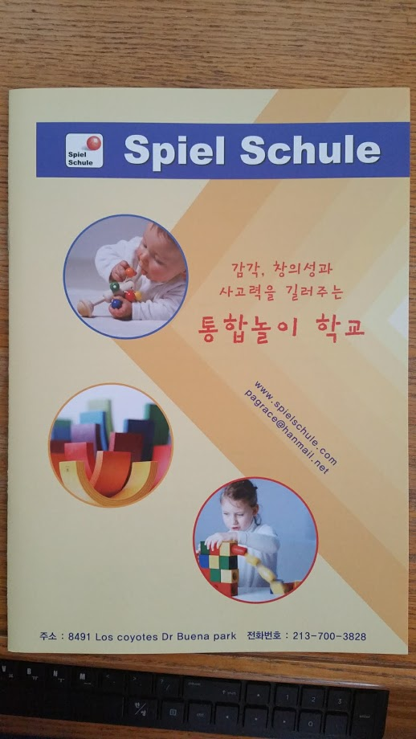
[Web Site]
www.canaanspielschule.com
[Instargram]
Pagrace_
[Youtube]
Grace Lee와 함께하는
[Address]
8491 Los Coyotes Dr, Buena Park, CA 90621
[Phone Number]
213-700-3828
[E-mail]
pagrace0402@gmail.com

Slide 3
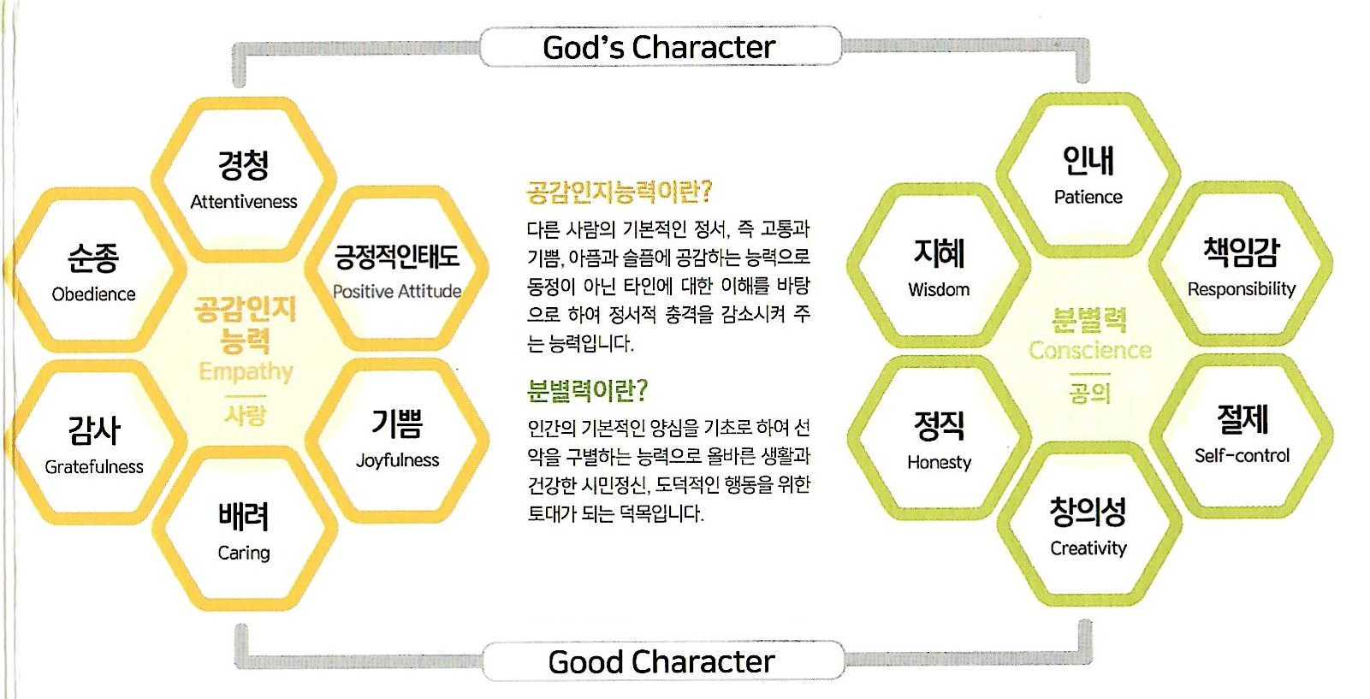

Slide 4
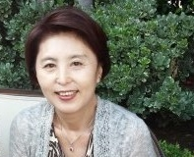
Introduction
WELCOME TO OUR SCHOOL
We are excited that you have chosen to consider our program for your child. Spiel Schule provides the highest quality age –appropriate program for your child .
Our comprehensive learning program encourages each child’s cognitive, social, emotional, and physical development .
The small class size and direct personal attention we provide assure an environment where children “love to play and learn”
Thank you.
저희 학교에 오신것을 진심으로 환영합니다.
여러 학교 중에서 저희 학교를 선택해 주신것을 진심으로 기쁘게 생각합니다.
Canaan Spiel Schule 에서는 어린이들의 발달에 맞는 우수한 프로그램으로 교육하고 있습니다.
또한 다양한프로그램은 어린이들의 신체적, 정서적, 사회적, 인지적, 언어발달을 골고루 돕고 있습니다.
개개인에게 관심과 사랑을 나눌수 있는 좋은 환경입니다.
여러분의 소중한 자녀들이 마음껏 즐겁게 놀며 배우는 장소가 될것입니다.
감사합니다.

Slide 5
Policy Regulation
ADMISSIONS
. Children must be between the ages of 1-5years.
. We will be toilet training the children.
. New children are admitted to the school on a first come, first served basis.
TUITION (2/1/2026)
. 18 Month under $1,900
. 24 Month under $1,850
. 36 Month under $ 1,800
. 36 Month older $ 1,750
. Diaper $50
. Registration $200
. Tuition is paid in advance
. Refunds for absences and holidays will not be allowed.
. A charge of $10.00 for every minute will be made for any child remaining after 5:15 pm .
. If the child misses one month, 2/3 of the tuition has to be paid for keeping his/her place.
HOURS
. Monday-Friday 8:00 am - 5:00pm
PROGRAM
. Physical growth (gross, five motor skills )
. Language Skills (story)
. Pre-Math and Science Concepts (Gabe & Selecta)
. Music & Movement(Worship, Poem)
. Creative Art Experience
. Dramatic play
. Social interaction (Selecta)
. Special Activities
. Cognitive (Comprehension, problem solving)
. Self- Esteem (Self-Awareness & Positive self –image)
NUTRITION
. Breakfast 9:30 – 10:00 am
. Lunch 12:00am (1 time/month)
. Snack 4:30pm

Slide 6
입학자격
. 만 1세부터 5세까지 입학할수 있습니다.
. 대. 소변 훈련을 시킵니다.
. 등록하는 순서대로 입학 하게됩니다.
운영시간
.월요일부터 금요일 8:00am-5:00pm
수업료 (2/1/2026)
. 18개월이하 $1,900
. 24개월이하 $1,850
. 36개월이하 $ 1,800
. 36개월이상 $ 1,750 (Diaper: $50)
. 입학금 및 부대비 $200
. 할인은 없습니다.
. 오후 5:15 이후 데려가실경우는 5분마다 $10 을 추가합니다.
. 한달결석할경우 수업료의 2/3를 납부하셔야 자리를 확보할수있습니다.
교육내용
. 신체발달(대근육/소근육)
. 언어교육
.수학,과학개념
.음악과 율동
.창작놀이및 활동
.모방놀이
.사회성발달
.특별활동
.인지( 이해력, 문제해결능력)
.자긍심(자아개념/긍정적 자아의식)
식사 (식단은 매월발부)
. 아침식사 오전 9:30 – 10:00
. 점심시간 오전 12:00
. 간식 오후 4:30

Slide 7
Rules
WITHDRAWAL A Two Week notice must be given to the office before you withdraw your child from the school for any reason.
If the notice is not given, you must pay the full tuition for those two weeks.
If you drop out suddenly (during the semester), no refund will be given.
HEALTH Any child with a cold, fever, diarrhea, vomiting or any other contagious disease can not be accepted for the protection of the other children. We will only administer prescription medicine with the child's name on the original bottle. A medicine release is obtained from the front table and should be completed with the child's name, dosage, time, and parent's signature.
SHARE DAY Friday is share day at the school. This day is set for the children to bring a toy to share with their friends. (No guns, no war toys, no pets, no toys with a lot of small pieces, and no expensive or fragile toys) Please mark the toy with your child's name.
BIRTHDAYS We celebrate birthdays because each child is special and needs this special time to feel very important. If you would like to celebrate your child's birthday at the school, you may bring a cake to share with his/her classroom friends. Please notify the teacher in advance.

Slide 8
ARRIVAL & DEPARTURE For your child's protection, we are asking that you accompany your child to the school and sign your child in and out daily. No one will be permitted to take a child off the premises without the written consent of a parent.
A person of at least 18 years of age must sign your child in and out.
DISCIPLINE The school strives to help each child learn and use appropriate behavior. Positive reinforcement and time outs are used to help modify children's behavior. Effort will be made to enhance the child's self-esteem, and teachers will try to help the child understand that certain behaviors are inappropriate.
CLOTHING Each child needs a complete set of extra clothes in a ziplock bag at school with the child's name. A ziplock bag is ideal for keeping the clothes together and sending home soiled clothing. Clothing worn at school should allow for comfort and durability since children get dirty playing, painting, and enjoying their day. Please send your child in soft-soled shoes or tennis shoes.
BLANKET Please provide 2 small blankets for your child to nap on. Blankets should be taken home bi-weekly for laundering.

Slide 9
Holidays
New Year's Eve New Year's Day Martin Luther King, Jr. Day President's Day Memorial Day Independence Day Labor Day Columbus Day Veterans Day Thanksgiving Christmas Day Summer vacation Winter vacation | Dec. 31 Jan. 1 3rd Mon. in Jan. 3rd Mon. in Feb. Last Mon. in May July 4 1st Mon. in Sept. 2nd Mon. in Oct. Nov. 11 4th Thur. & Fri. in Nov. Dec. 24 & 25 July (5 day) Last After Christmas (5 day)

Slide 10
Canaan Daycare 2025년 Events
7M (July)
4th (Fri) Independence Day ◯
21th(Mon)-25th(Fri) Summer vacation ◯ (5day)
8M (Aug.)
8th (Fri) Graduate (A.M. Care)
9M (Sept.)
1th(Mon) Labor Day ◯
10M (Oct.)
13th(Mon) Columbus Day ◯
24th(Fri) Field trip (Pumpkin farm)
11M (Nov.)
11th(Tue) Veterans Day ◯
27th(Thur)-28th(Fri) Thanksgiving Day ◯ (2day)
12M (Dec.)
19th(Fri) Canaan Festival
25th(Thur) Christmas Day ◯
26th(Fri)-31(Wed) Winter Vacation ◯ (4day)
1M (Jan.)
1th (Wed) Happy New Year ◯
20th(Mon) Martin Luther King ◯
2M (Feb.)
14th (Fri) Valentine Day
17th (Mon) President Day ◯
3M (Mar.)
17th(Mon) St. Patrick's Day
4M (Apl.)
17th (Thur) Happy Easter event
18th (Fri) Good Friday ◯
5M (May)
16th (Fri) Field Trip (Zoo)
26th (Mon) Memorial Day ◯
6M (June)
13th (Fri) Family Sports Day
19th (Fri) Juneteenth Day

Slide 11
Monthly Theme
SEPTEMBER | LEARNING ABOUT OURSELVES AND OTHERS Getting to know one another, Self-Concept, Friends and School
OCTOBER | HARVEST TIME AND THE FARM Colors, Foods, Farm and farm animals, Halloween
NOVEMBER | HOME AND FAMILY My family, My home and neighborhood, American Indians
DECEMBER | THE SPIRIT OF THE SEASON Giving and sharing, Children around the world
JANUARY | WINTER Getting a fresh start, Health and safety, Snow, water, and ice
FEBRUARY | COMMUNITY WORKERS Doctor, nurse, dentist, police officer, and firefighter
MARCH | SPRING A new beginning, Plant life, Air, rain and sunshine, Balance of Nature
APRIL | ANIMALS Forest animals, Zoo animals, Circus Animals
MAY | FIVE SENSES Sight, Smell, Hearing, Taste, Touch
JUNE | TRAVEL AND TRANSPORTATION Vacation and trips By land (Truck, Bus, Car), By Rail (Train), By Water (Sailboat, Boat), By Air (Propeller, Airplane)
JULY | SUMMER Ocean, rivers, and lakes, Insects
AUGUST | SPORTS Baseball, Basketball, Soccer, Swim

Slide 12
Daily Schedule
8:00~9:00 9:00~9:30 9:30~10:00 | 등원 / Free Time Free Time / 자유놀이 (Drawing, manipulative, dramatic play, etc) Breakfast / 아침식사
10:00~11:00 | Lesson One, Outside play / 바깥놀이 Art, language, math, science, GB & selecta. montessori, etc. (창의적 미술 활동, 언어, 수, 과학 등) sand play, jungle gym, ball, water play etc. (모래놀이, 정글짐, 공, 물놀이)
11:00~11:30 | Circle Time, Lesson Two / 이야기 나누기 Greetings, calendar, weather, sing-along, etc. (인사, 달력, 날씨, 노래 등)
11:40~11:50 | Wash up for Lunch / 손 씻기, 점심준비
11:50~12:30 | Lunch, Clean Up / 점심시간, 정리
12:30~1:00 | Free Time, Get Ready for Nap / 자유놀이, 낮잠 준비 (Storytelling)
1:00~3:00 | Nap Time / 낮잠
3:00~3:40 | Clean Up, Brush Hair / 정리, 머리 빗기, 간식
3:40~4:30 | Free Time(Movement, art, practice various skills) Story Time / 동화 듣기 (창의적 음률 활동)
4:30 ~ 5:00 | 하교준비
5 Different activity areas for this class. GB & Selecta / Montessori / Story / Music / Dance / Craft 교실은 각 활동에 따라 5개의 영역으로 나뉘어 있습니다.

Slide 13
Education Method
Rhyme
Story performance
Poem
Phonics
Manner
Selecta
Sharing
Self-esteem
Self-awareness
& positive Self-image
Music
Science
Clay & Play
Feeling
Language
Arts
Emotionality
Sociality
Creative & Play School
Physical
Cognitive
Creative
Spiel
GABE & Montessori
Play art
Craft
Dancing
Painting
Fine motor skills
After special program: Worship, Music (Mon)
Music, Art (Tue)
Bible study, Singsong (Wed)
Poem, Rhythm(Korean, English) (Thur)
Special Event (Fri)
Monthly Cooking : 1 Time / Month
Math
Shape
Color
Reading
Writing
Make sentences

Slide 14
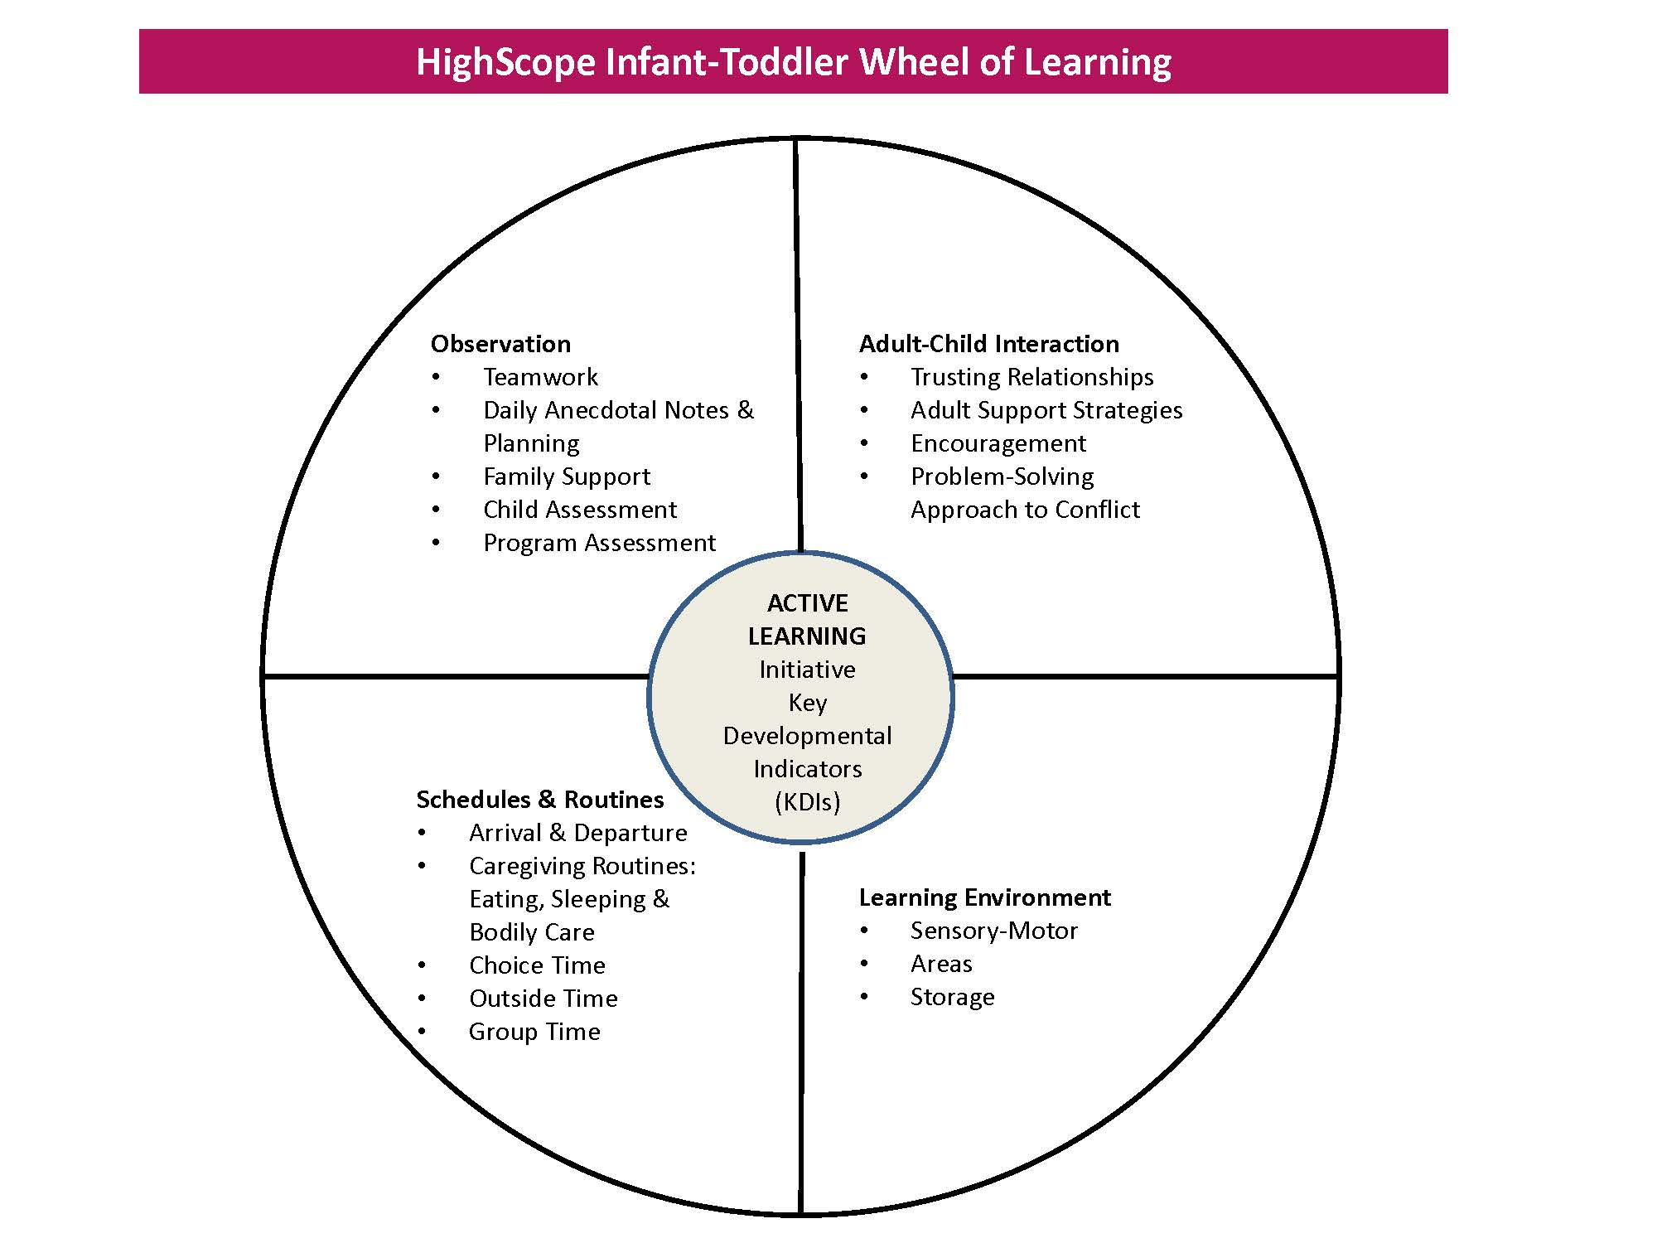
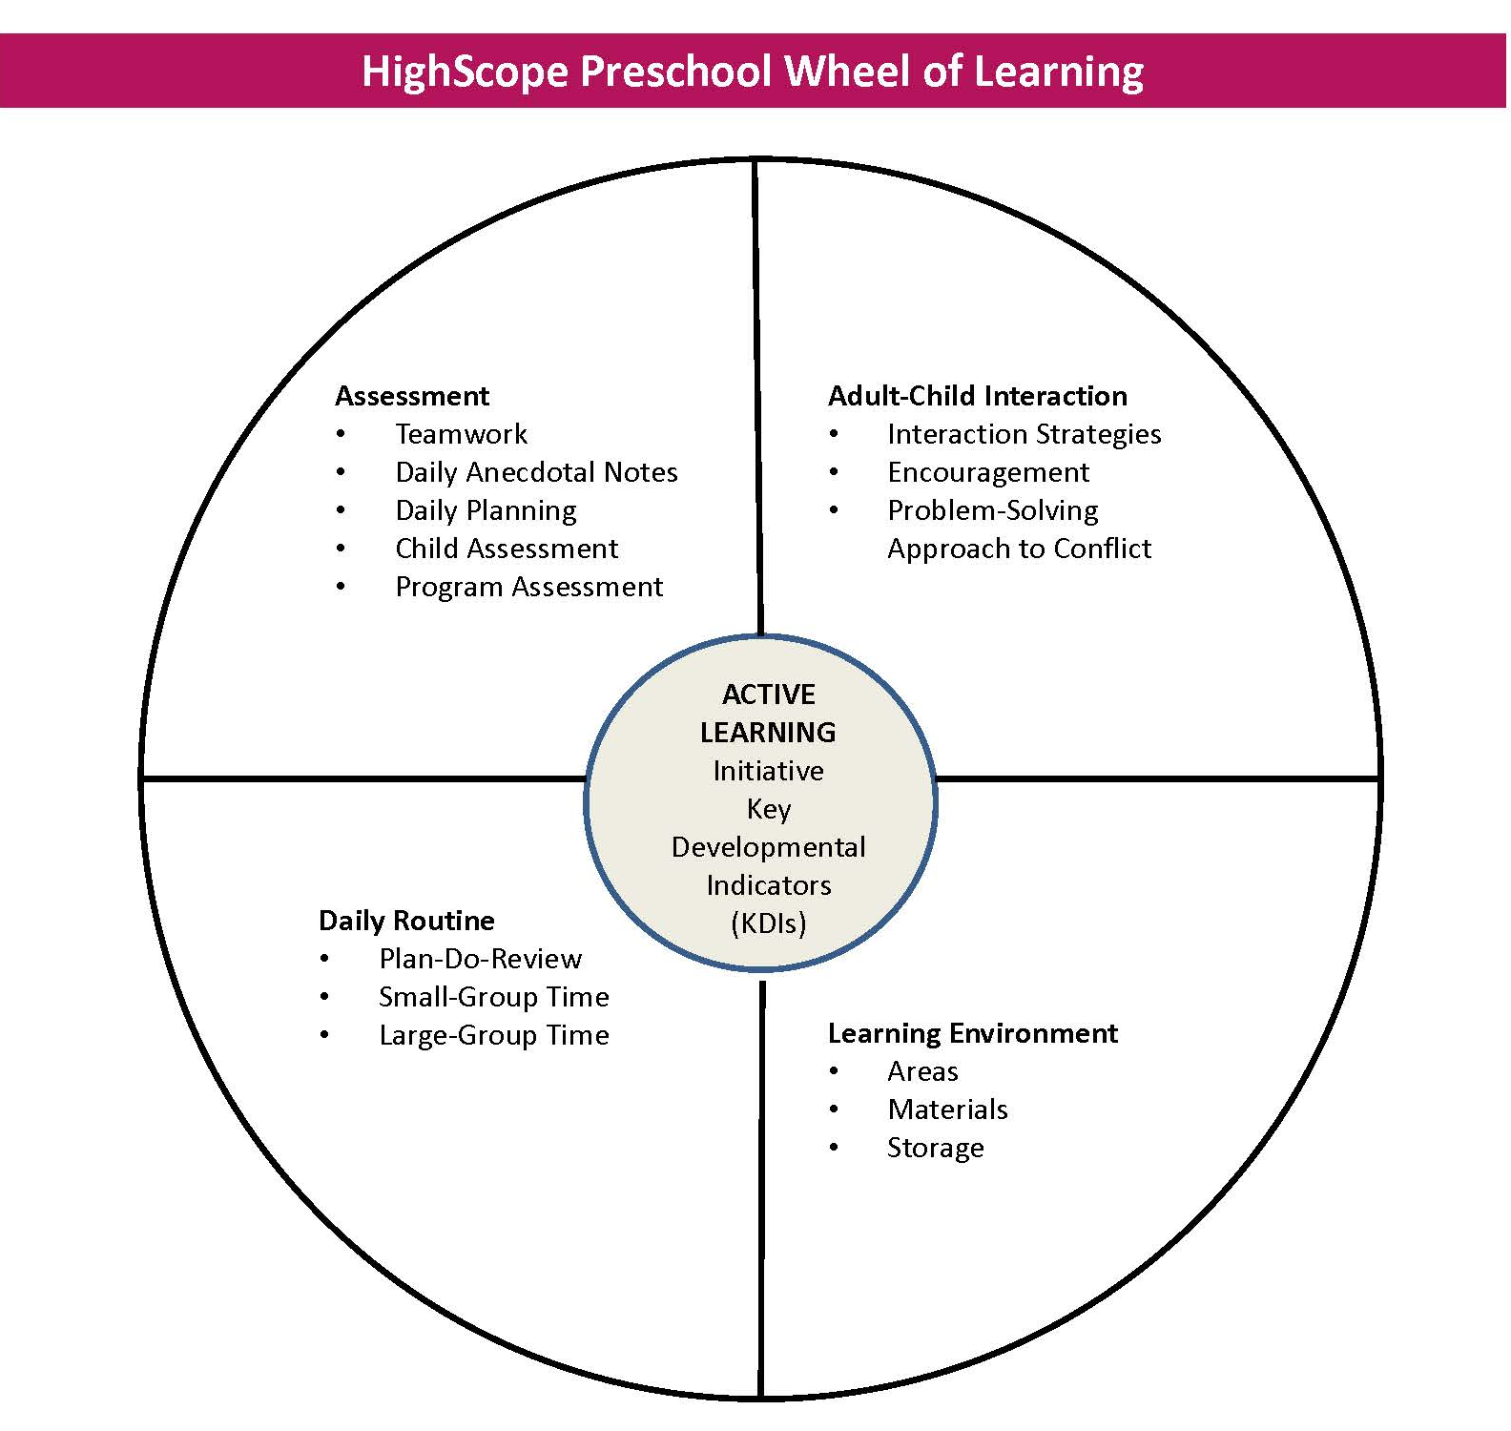
Highreach Curriculum

Slide 15
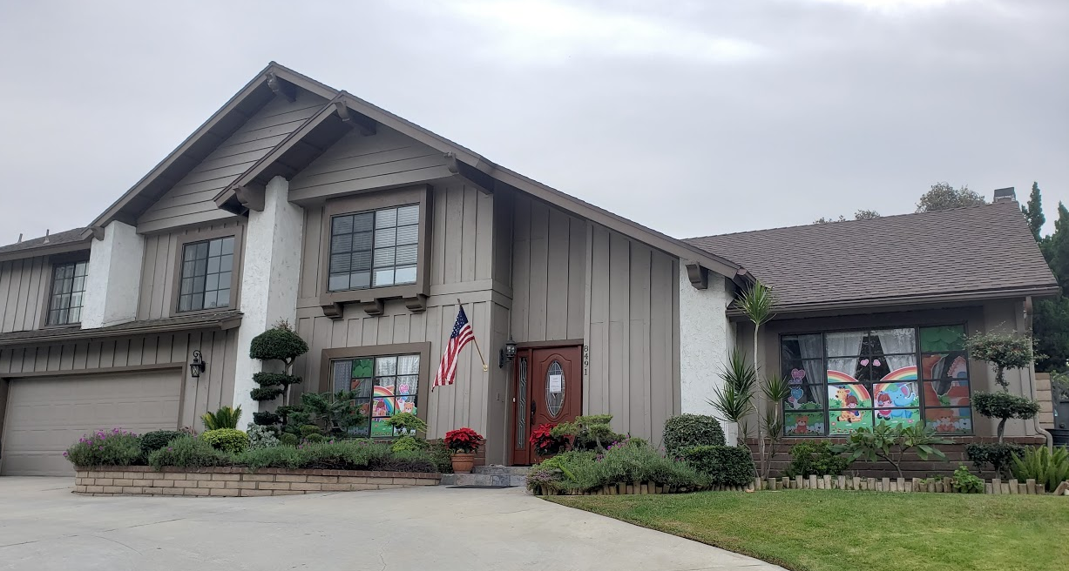
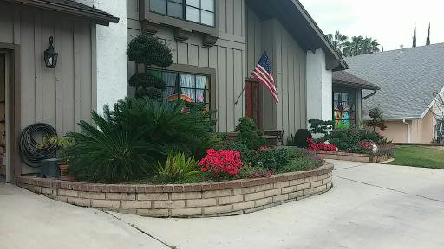
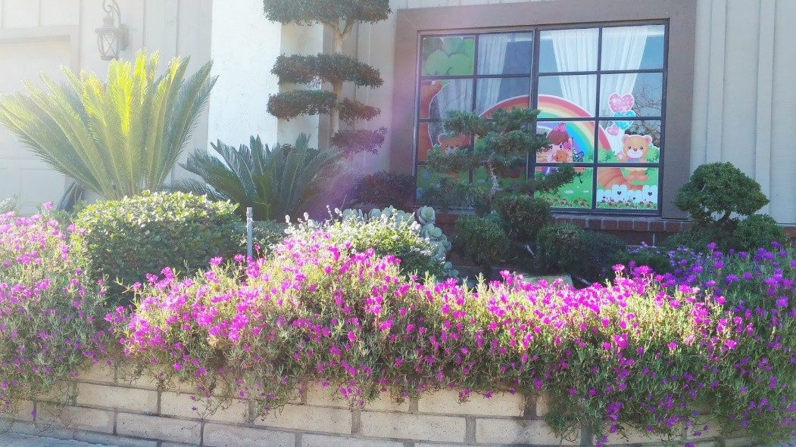
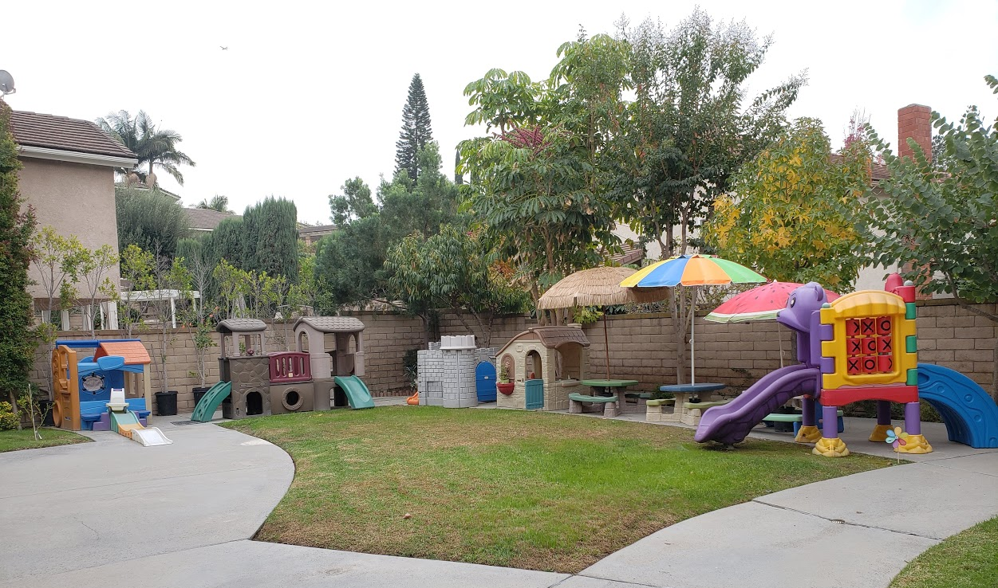
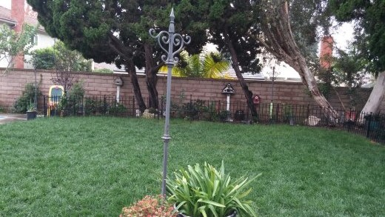
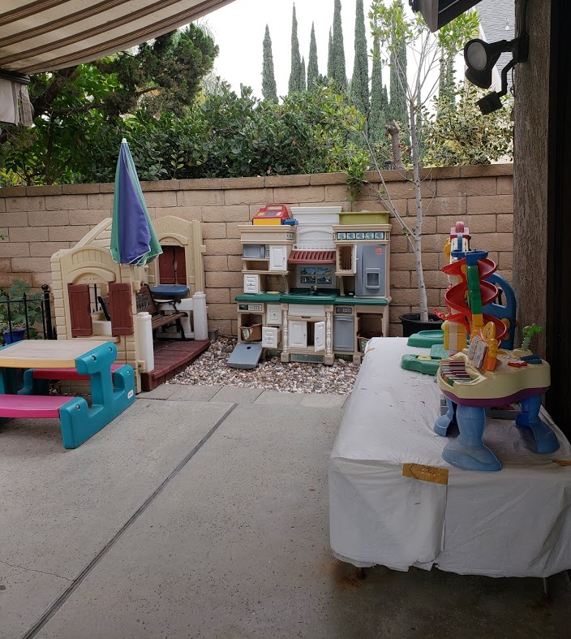
Outside View

Slide 16
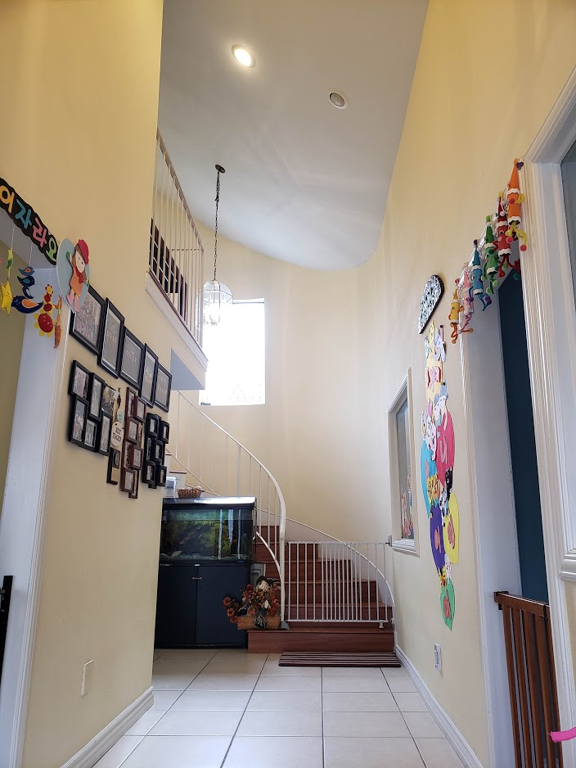
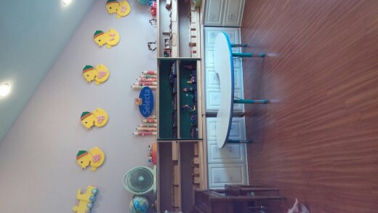
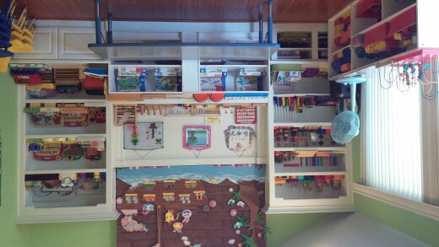
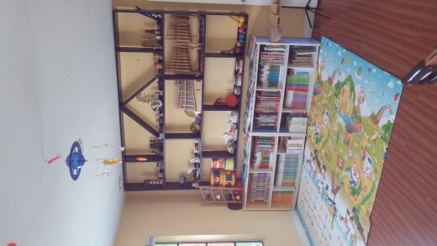
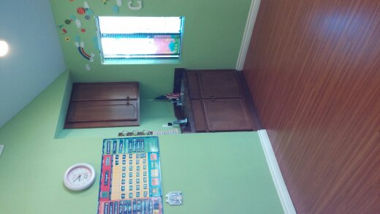
Inside View

Slide 17
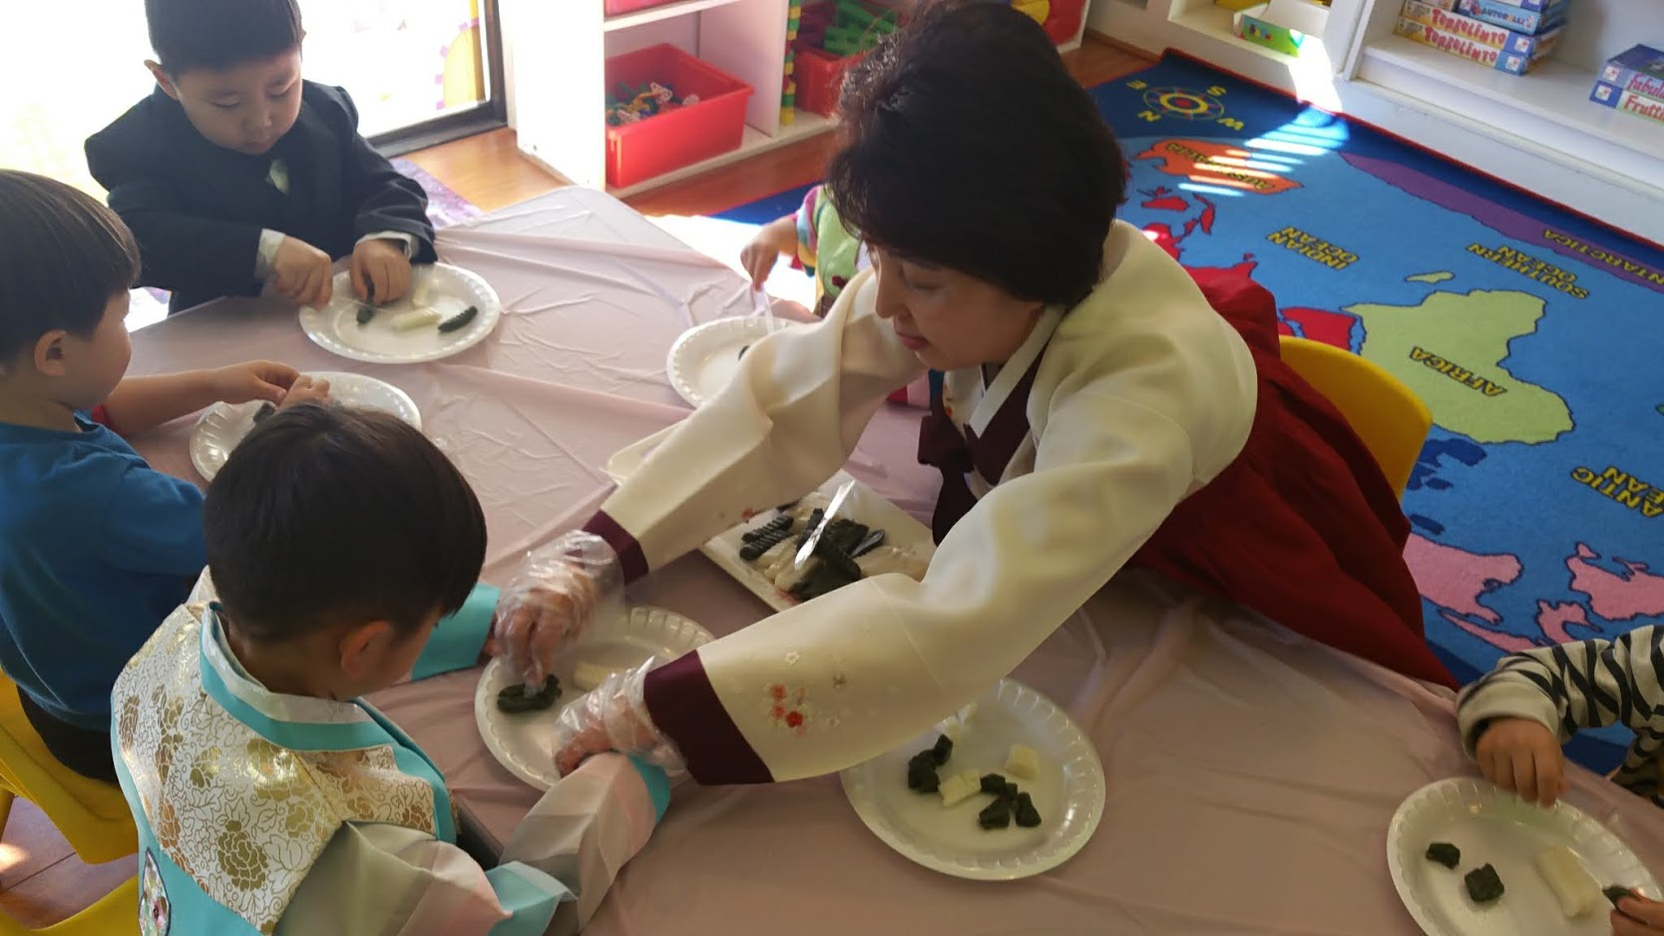
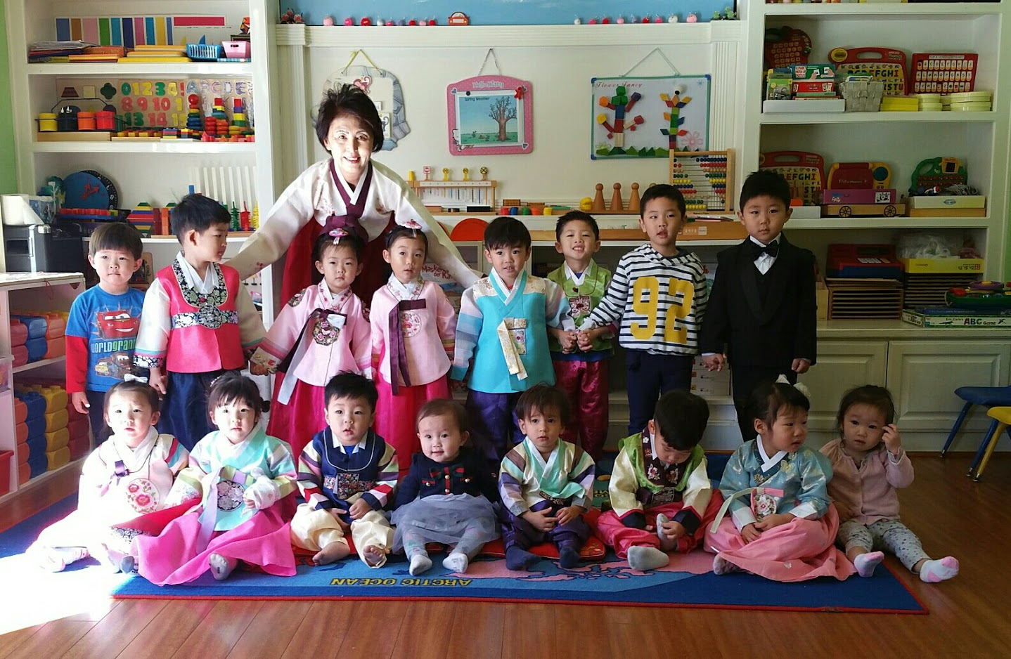
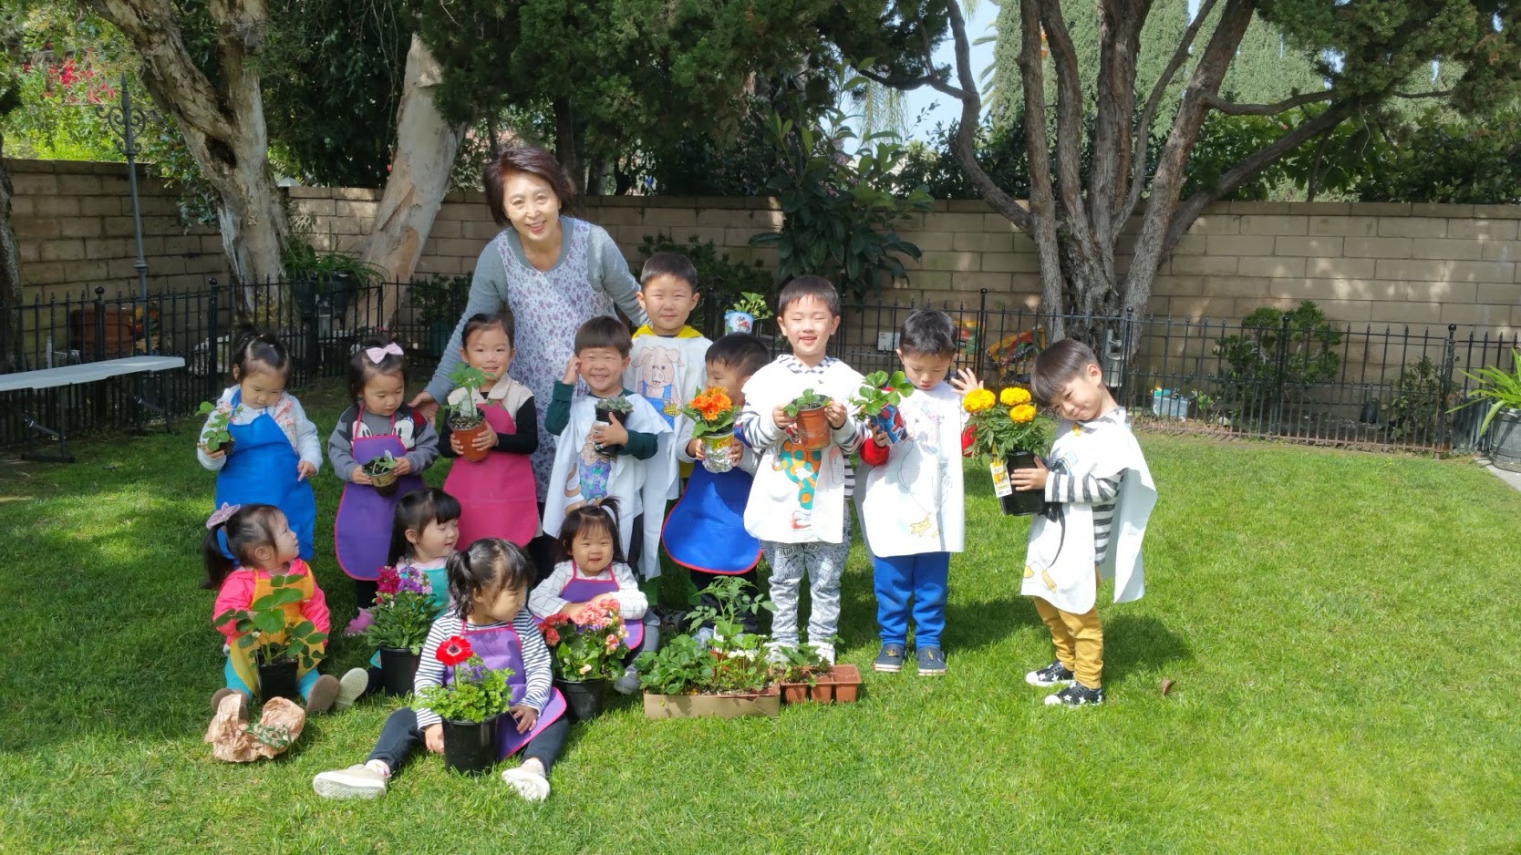
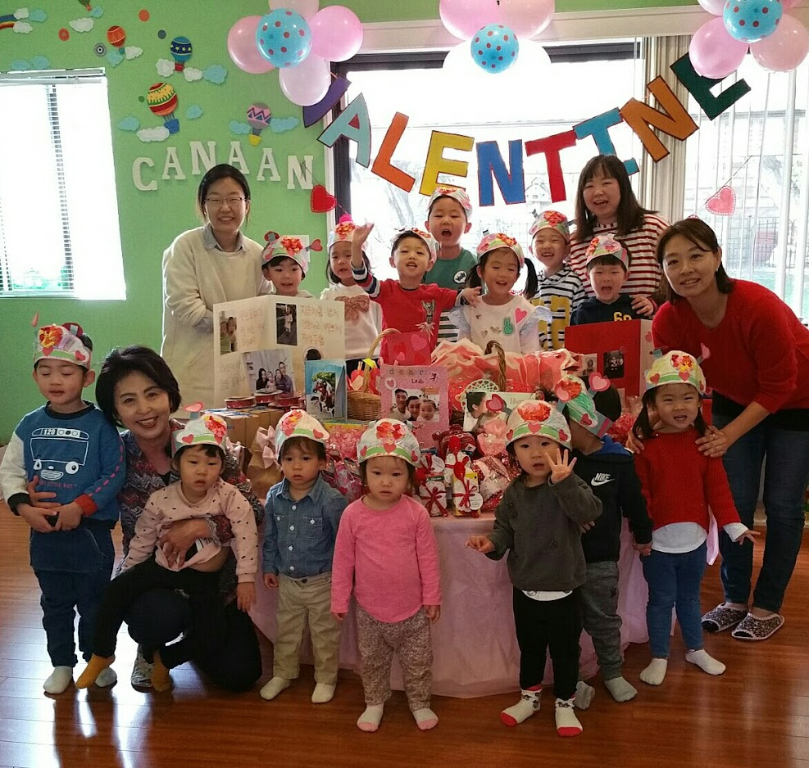
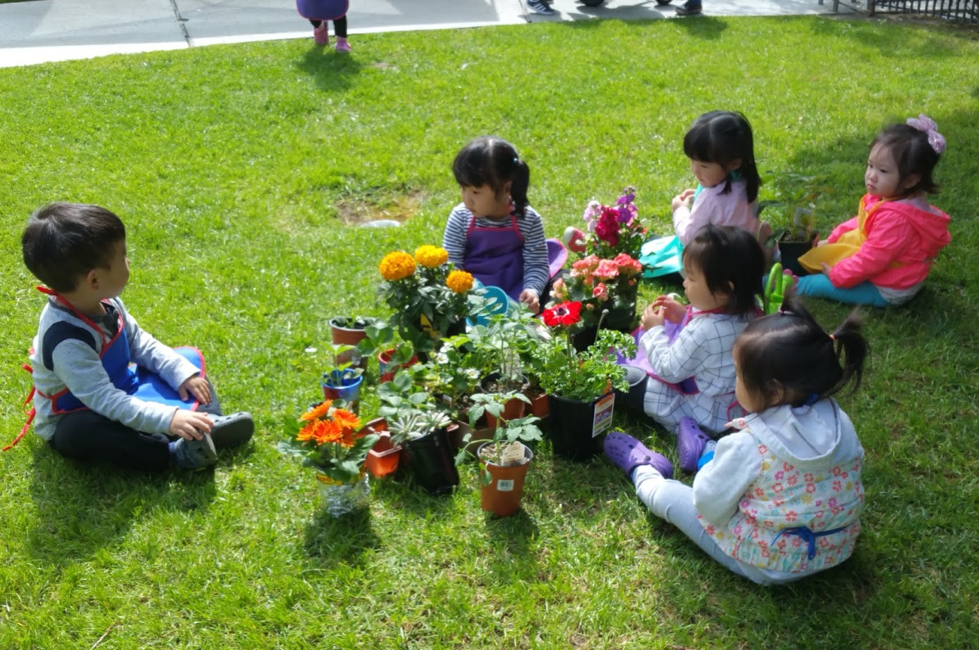
Events

Slide 18
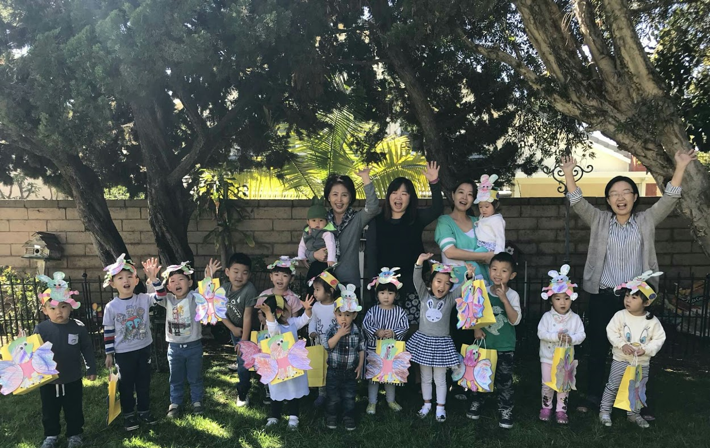
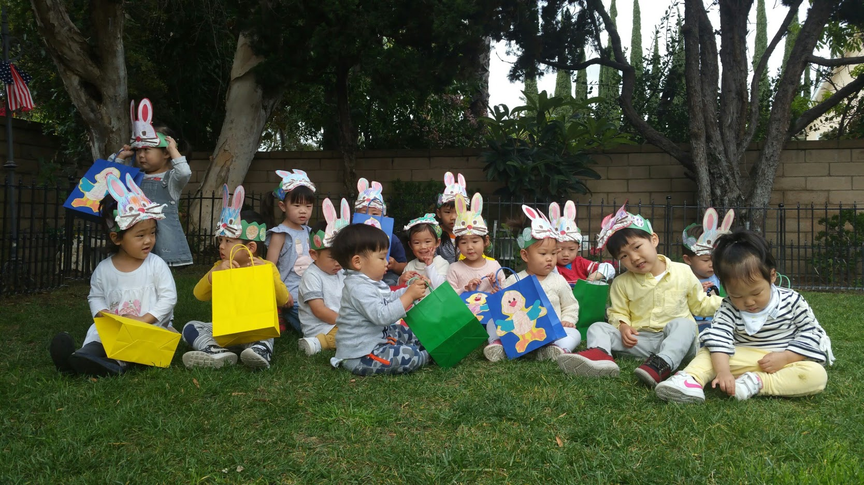
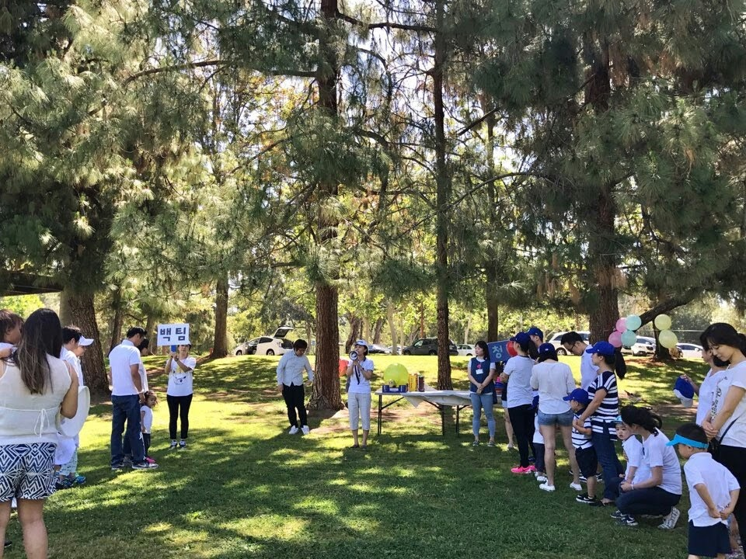
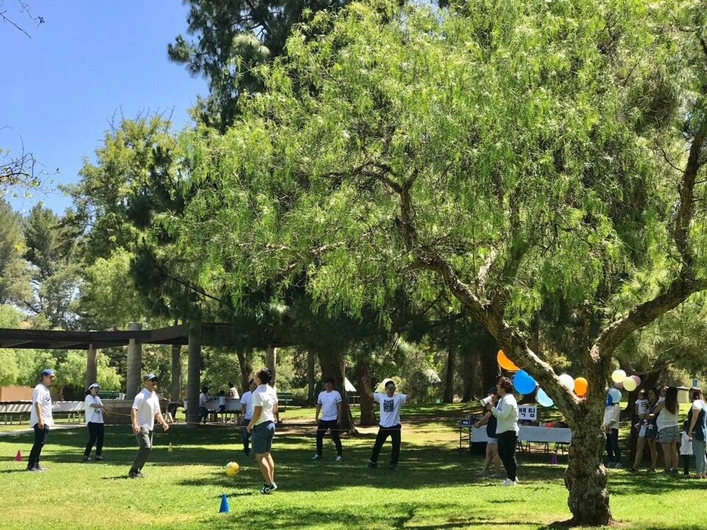
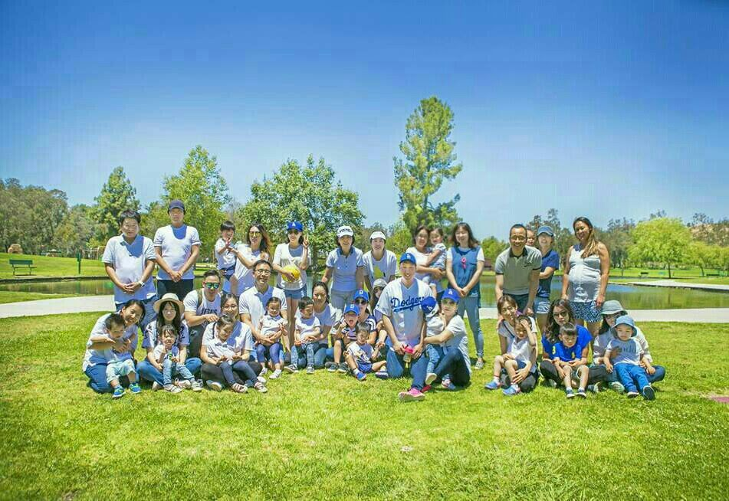
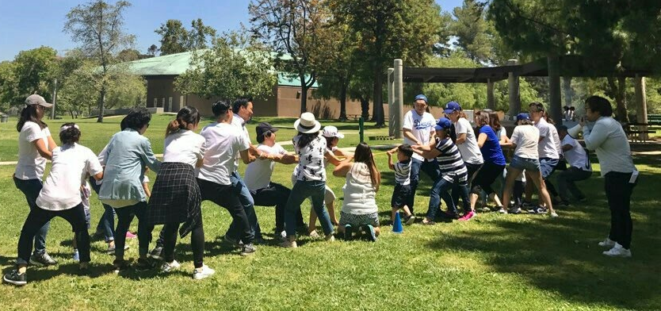

Slide 19
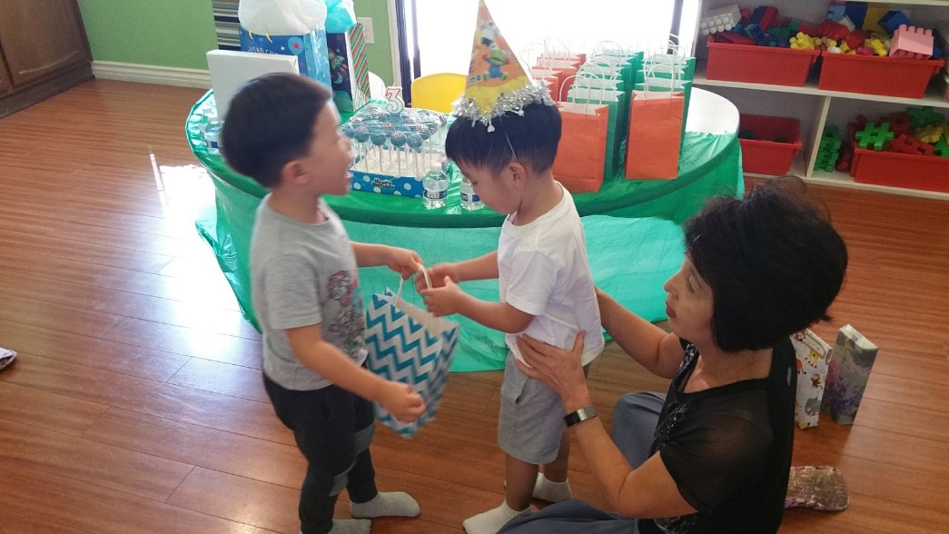
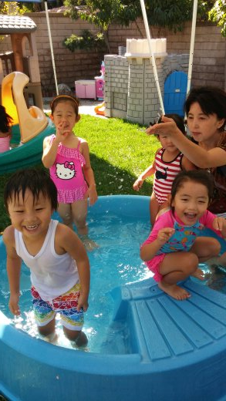
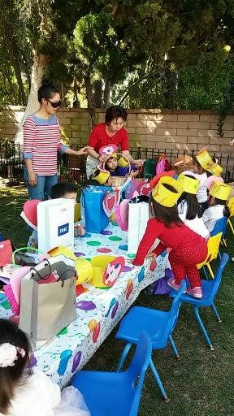
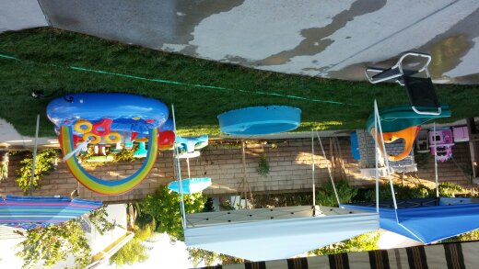
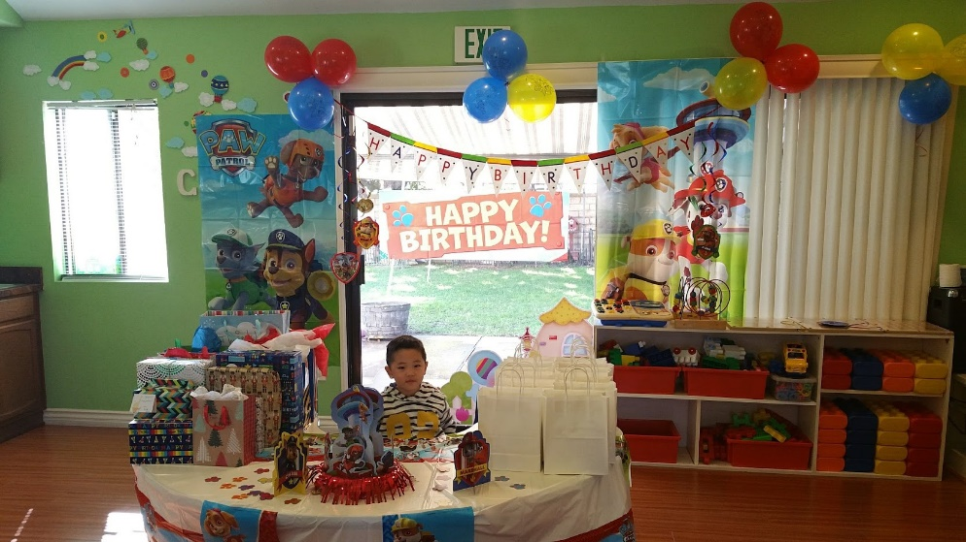

Slide 20
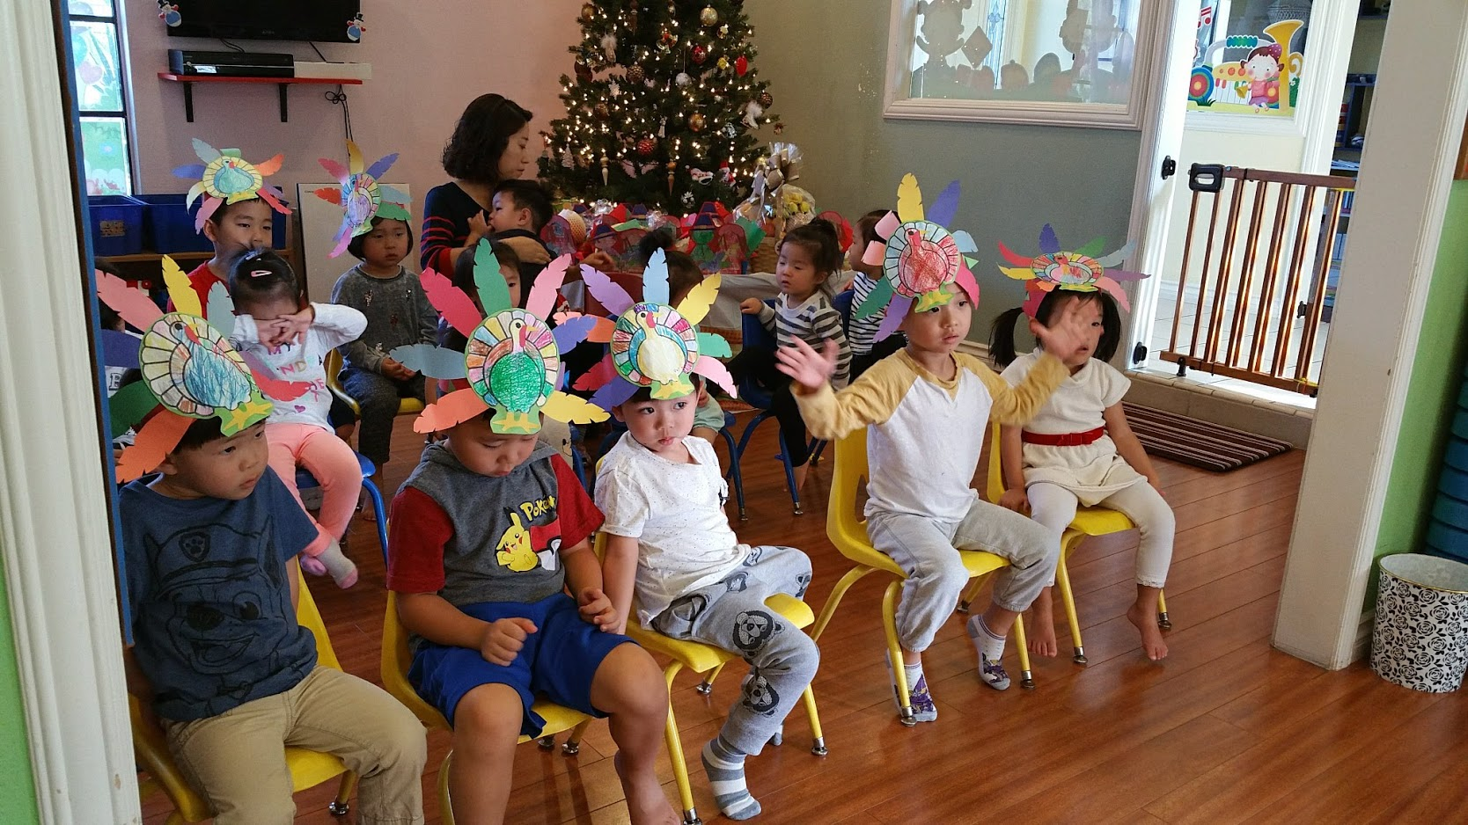
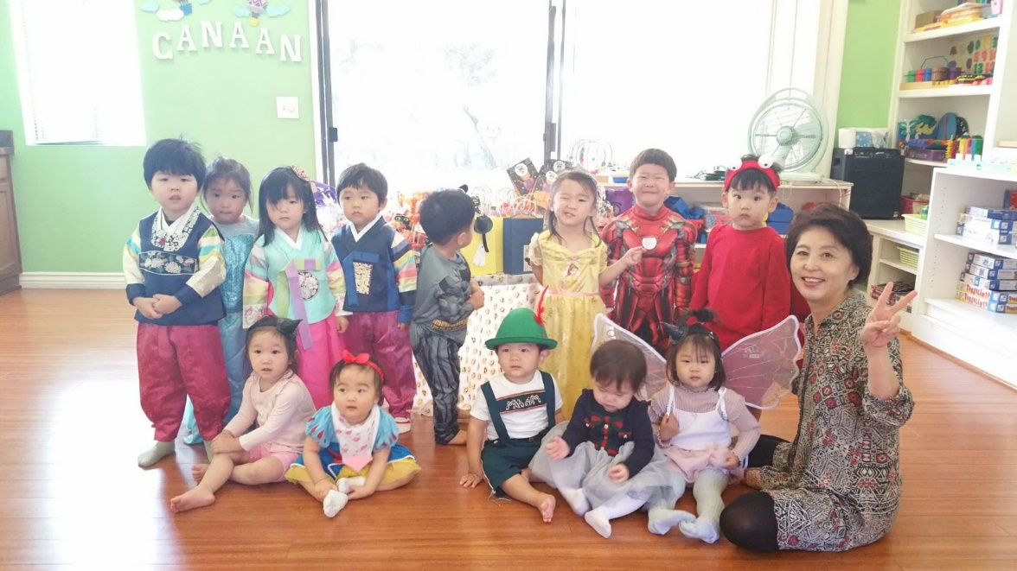
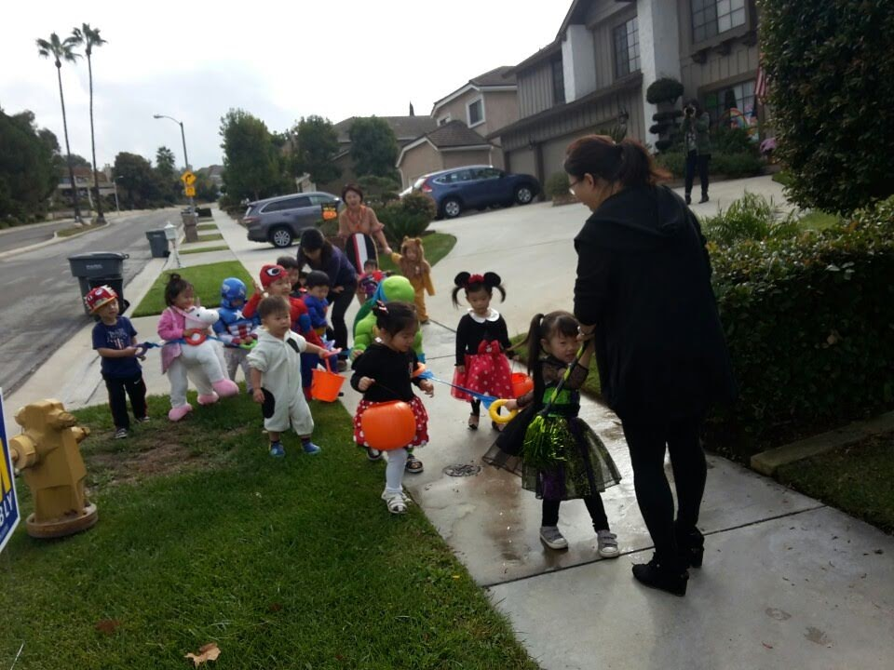
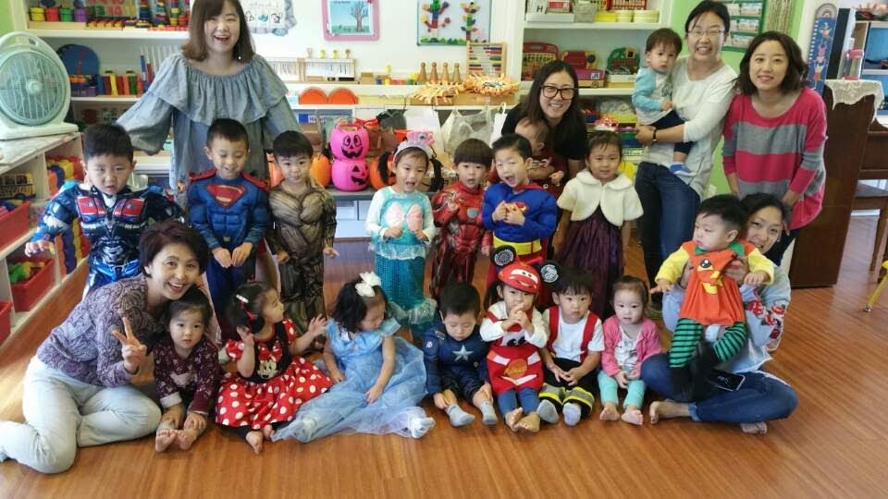

Slide 21
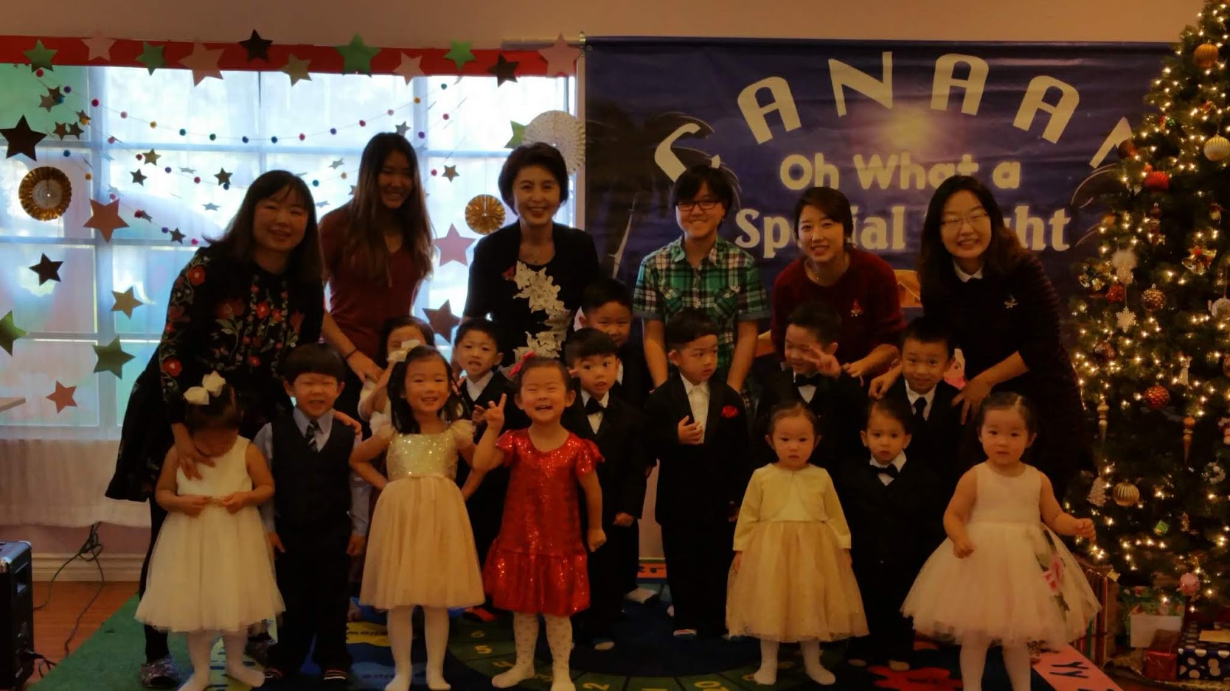
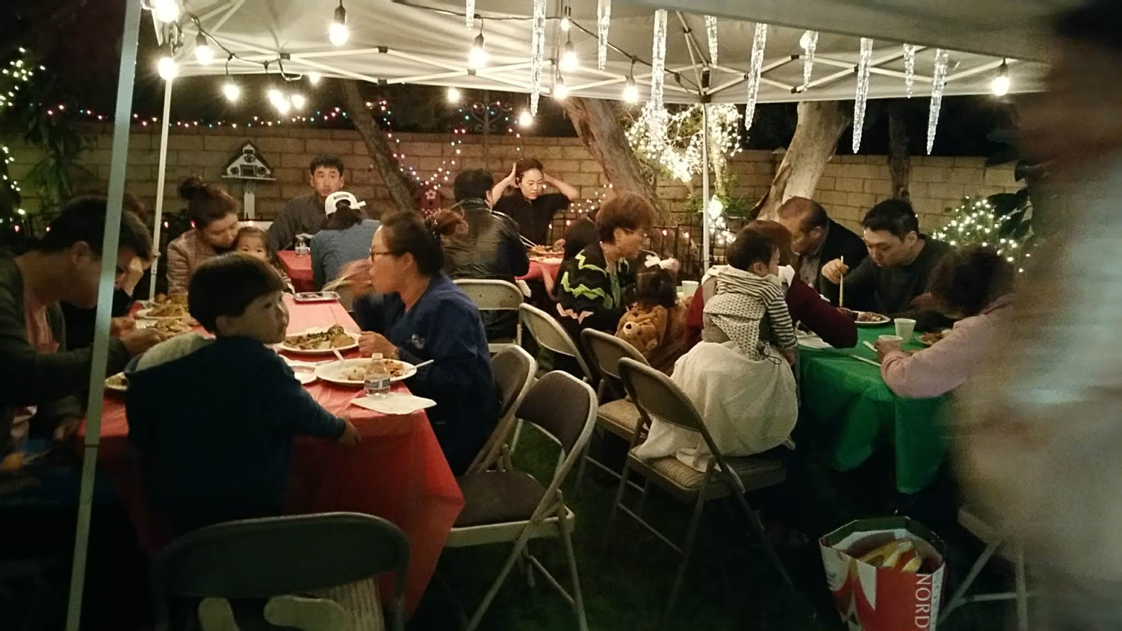
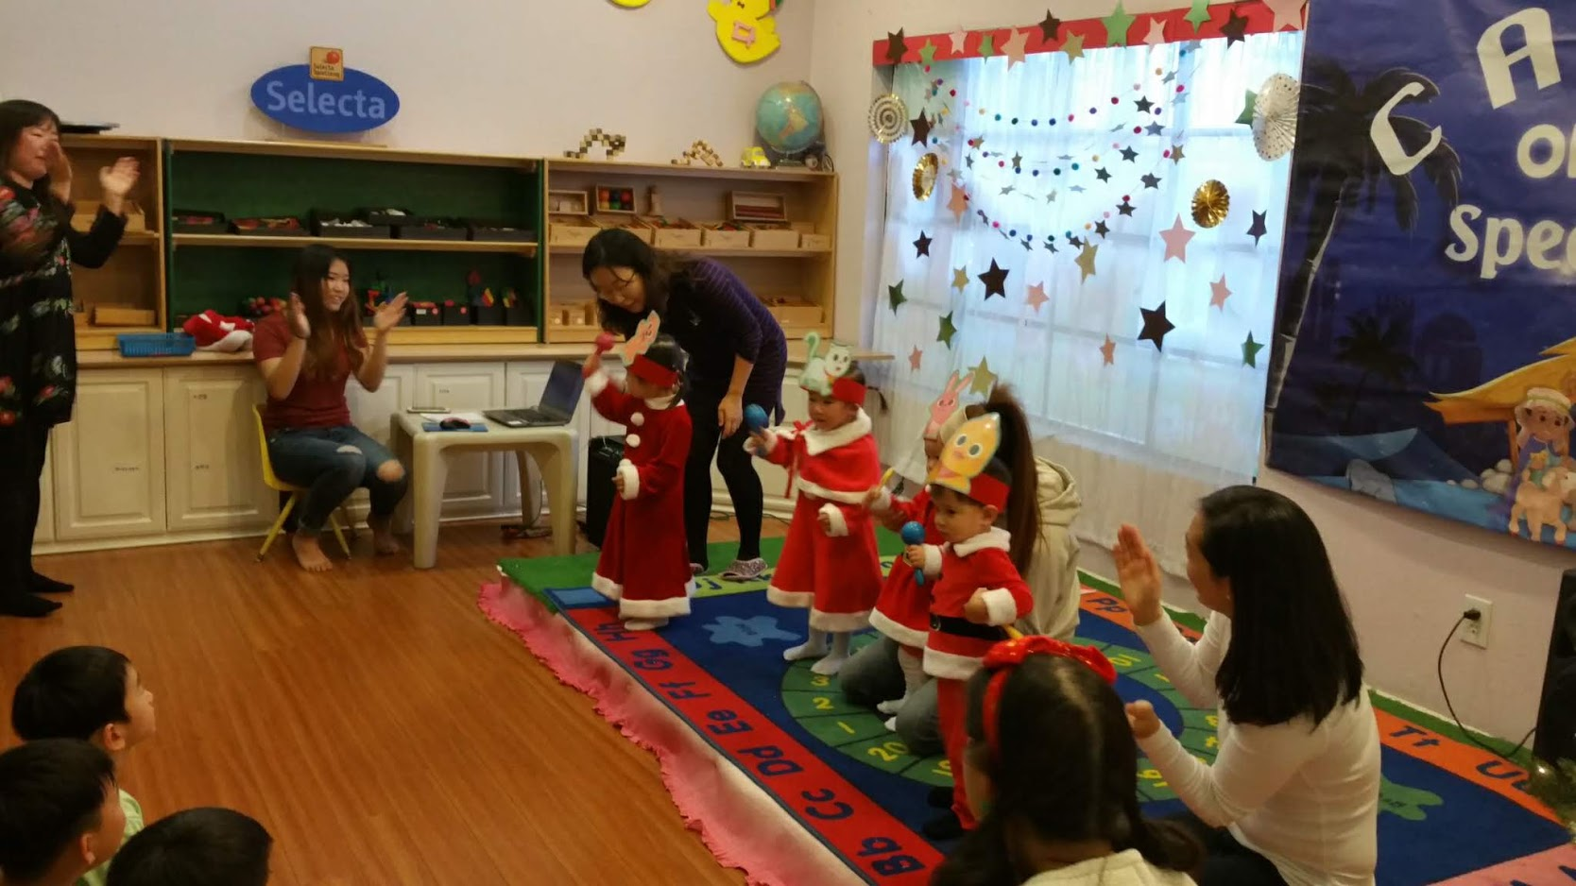
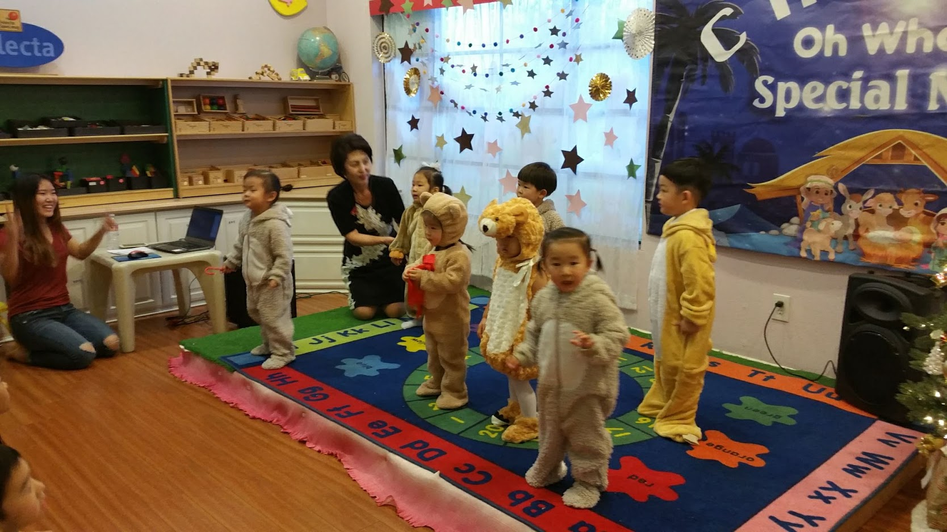

Slide 22
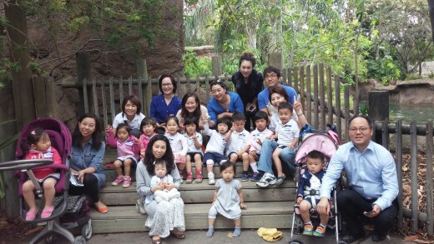
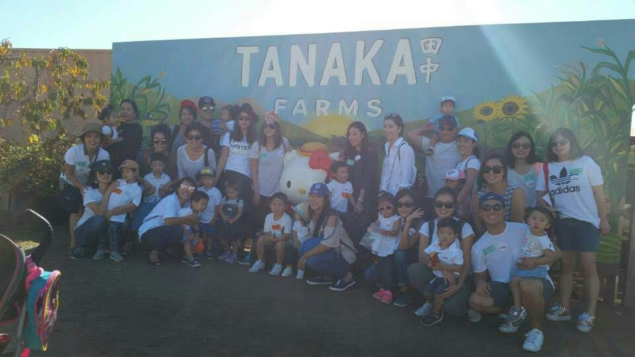
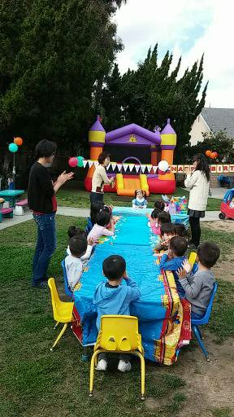
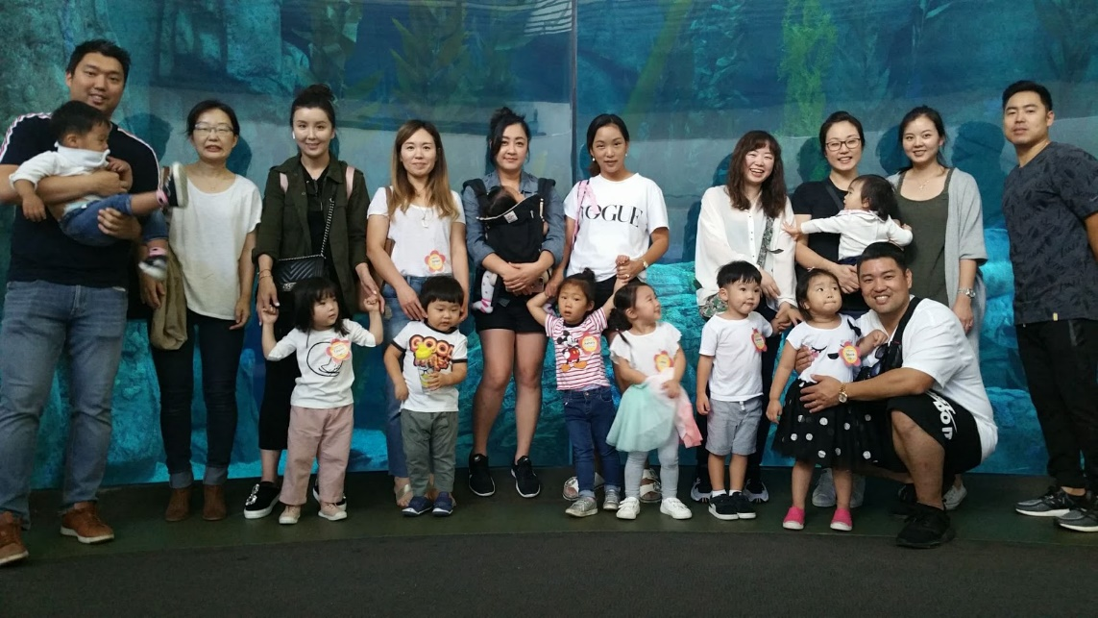
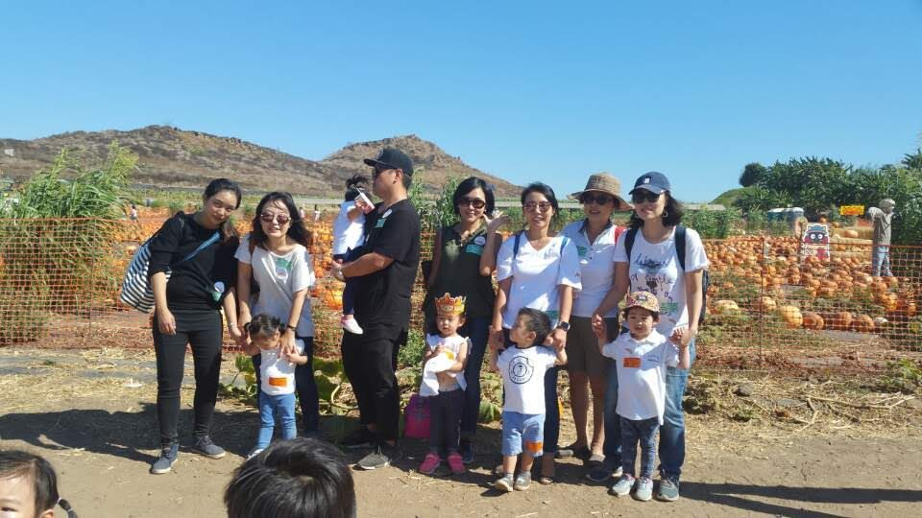
Field Trip

Slide 23
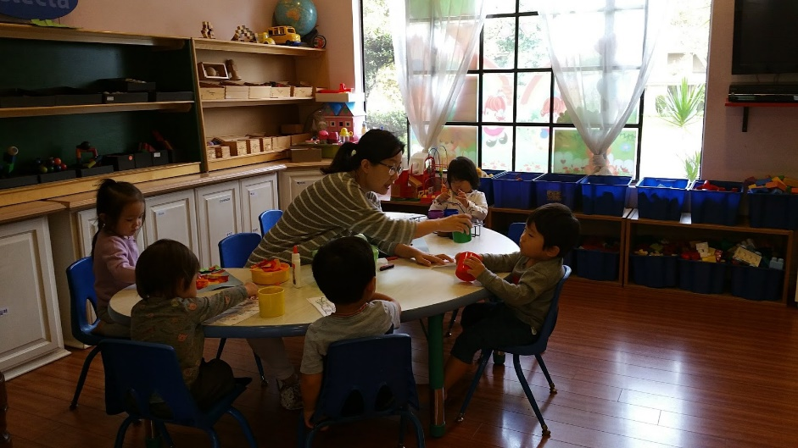
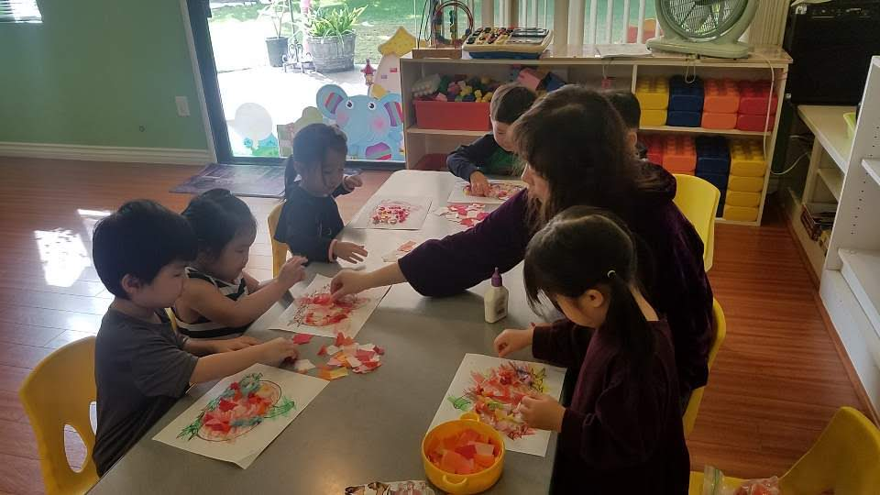
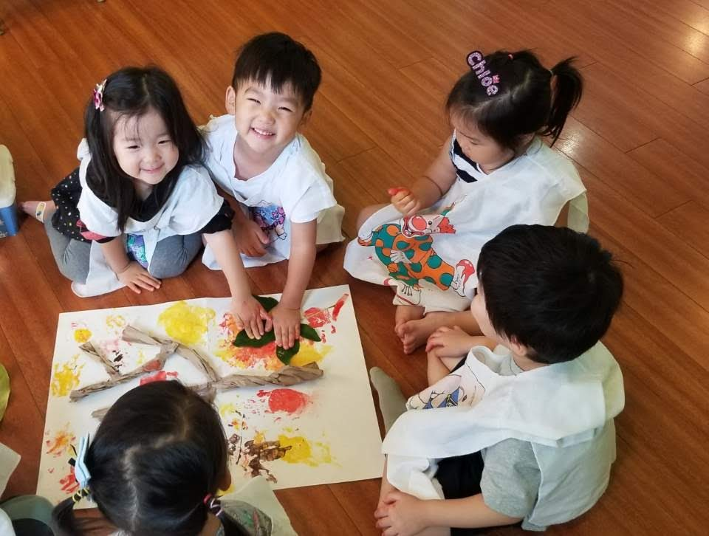
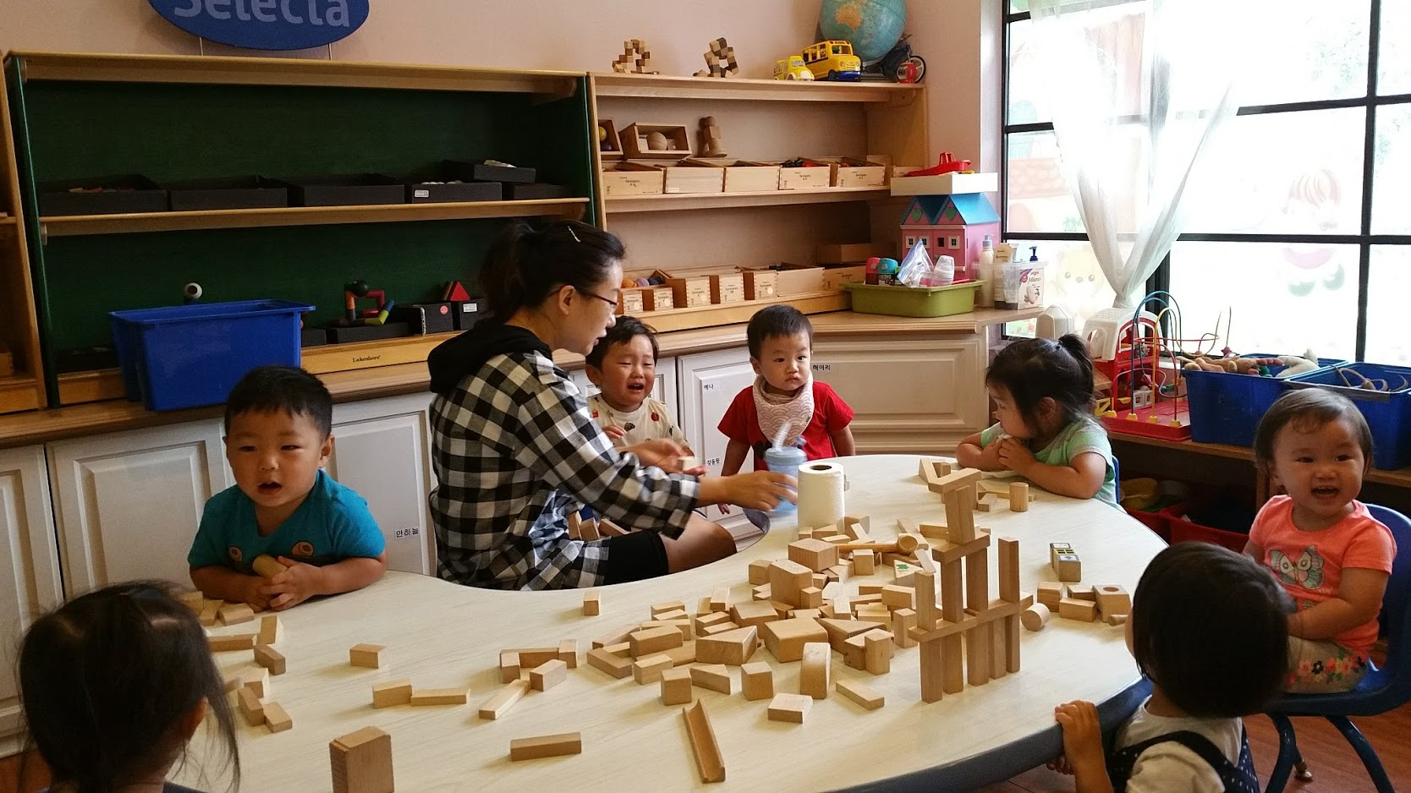
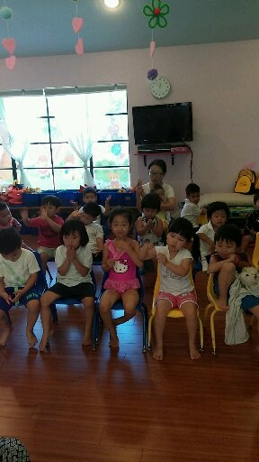

Activity

Slide 24








Slide 25



Parental Education
Pay attention and
Listen to the
Sayings of the wise;
Apply your heart.
To what I teach,
For it is pleasing when you
Keep them in your heart
And have all of them ready
On your lips.
Proverbs 22:17-18
NHA (Nurtured Heart Approach)
YCP (Learning how to play)
HUPE (Parent Education)

