Slide 1
Childcare Center
(Preschool and Kindergarten)

Slide 2
Licenses and Permits
Handled through the Child Care Licensing Division (CCLD) of the Department of Social Services (DSS).
You will need to attend an orientation session before you can apply
To schedule an orientation, you should contact the nearest state licensing agency
After you successfully complete the orientation, you will need to complete the license application

Slide 3
Application Information
what ages of children you will be taking care of (infants, toddlers, preschoolers, school-age)
what capacity you are seeking for children in each age range
whether you own the property where the care will be provided
whether your business will be for-profit or nonprofit
acknowledgments regarding knowledge of health and safety, criminal record, and other regulations

Slide 4
Licenses and Permits
You also will have to pay a license application fee; this fee will vary depending on the number of children you will be caring for
there may be local zoning laws that would stop running a child care business in a location

Slide 5
Health and Safety
California’s child care regulations are extensive
The CCLD has published readable “regulation highlights” documents that are available online
the state has the authority to inspect your operation
you should expect that a fire marshal or other fire prevention official will make an inspection to ensure there are adequate routes of escape in case of fire.

Slide 6
Tax Deduction
If you run your daycare business out of your home, you may be able to deduct expenses for the business.
To qualify, you must
  provide daycare to children
  be licensed by the state or exempt from the state’s licensing requirement

Slide 7
Insurance
There are particular risks associated with operating a child care center, primarily those related to the health and safety of infants and small children
Try to work with an insurance agent who has previous experience writing policies for child care providers.
Consider coverage for sexual abuse or molestation, for corporal punishment, and for employees who are child care providers

Slide 8
Employees
learn how to:
  create a useful job application that does not include illegal questions
  check references or make other pre-employment inquiries -- again without violating privacy laws or otherwise seeking illegal information
  ask interview questions that are both useful and legally permissible.

Slide 9
There are state training requirements and rules relating to criminal records
It is required that there be at least one on-duty staff member at a child care center to be trained in pediatric CPR, first aid, and other health-related areas.
The Employer’s Legal Handbook, by Fred Steingold

Slide 10
Zoning Laws
Visit the city zoning division - The zoning division will review the plan to ensure that the proposed use is allowed in the zoning district in which the proposed facility is planned. In some cases, there may be a requirement to apply for a Conditional Use Permit to allow the facility to operate within a certain zoning district.

Slide 11
Zoning codes from the NYC Department of City Planning: M3-1 is heavy industries that generate noise, traffic, or pollutants
“My church is classified as m3 zoning.” Visit the the city zoning division – Apply for a Conditional Use Permit to allow the facility to operate within a certain zoning district.

Slide 12
학교 설립의 서류
Child care orientation ( CA department of social community care Licensing division)
14명이하와 이상의 차이점( 교육과정 2배)
Criminal Record
소방, 지진훈련, 청결
15시간의 Health & Safety class Certification , CPR & First Aid

Slide 13
교사의 서류
24 Unit 의 유아교육 이수 증
Criminal record ( Finger print)
MBTI및 MMPI
TB Test ( 병원 )

Slide 14
입학시 학교에서의 요구사항
부모자신을 알기위한 가정에서의 Check list (놀아주었던일)
저녁에 가정에서 일어나는 일들 그림. 단어 가져오기

Slide 15
학교에서 가정으로 보내는 Check list
오늘 아침에 감사한일나누기 표현
일주일동안 제일 많이 나누었던 대화 (기억나는단어 나누기)
같이 놀아주었던일나누기

Slide 16
학교에서의 행사
1주에 한번 교사회의 ( 아이들의 상황 나누기)
그룹으로 Activity 하기
부모교육 분기별로 외부강사초빙 하여 나누기( 혹은 6개월 한번 , 방학전)
교사 교육 ( NHA, YCP ) 교사교육실시

Slide 17
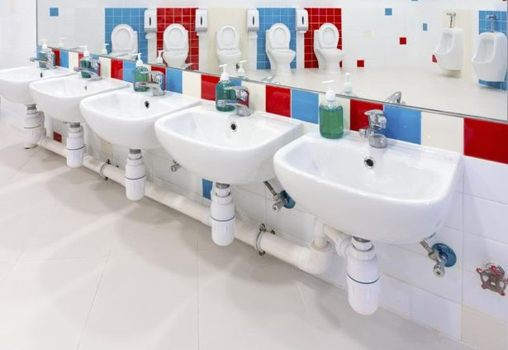
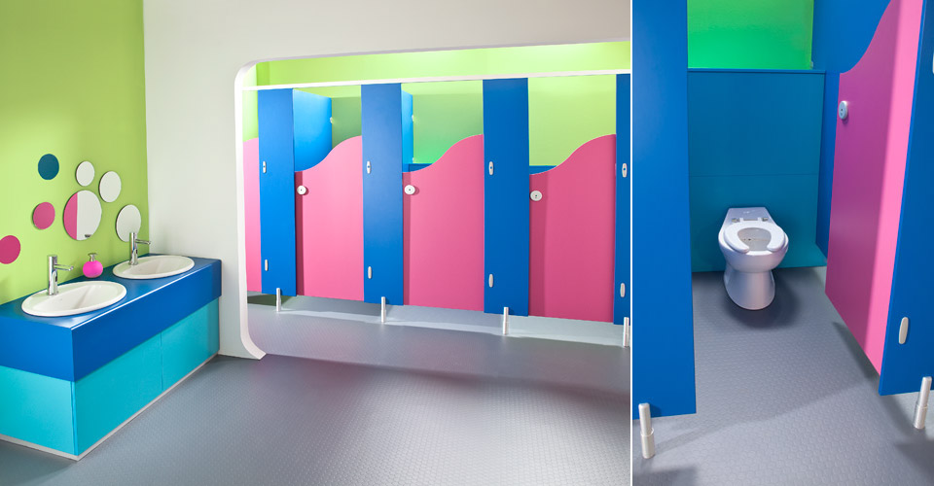
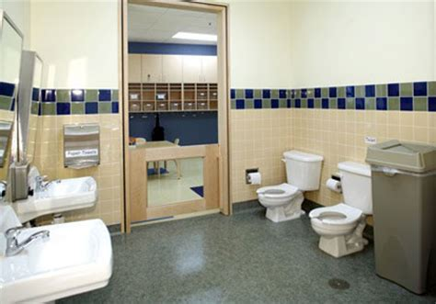
Bathrooms

Slide 18
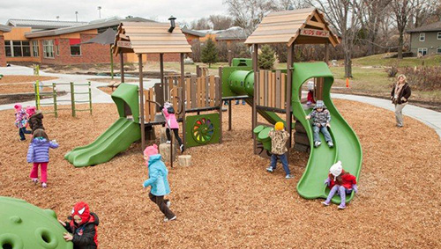
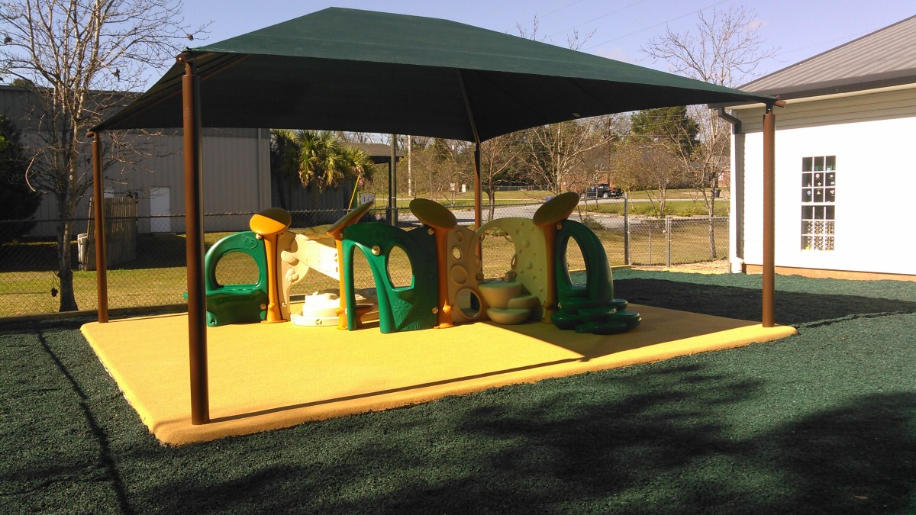
Playground

Slide 19
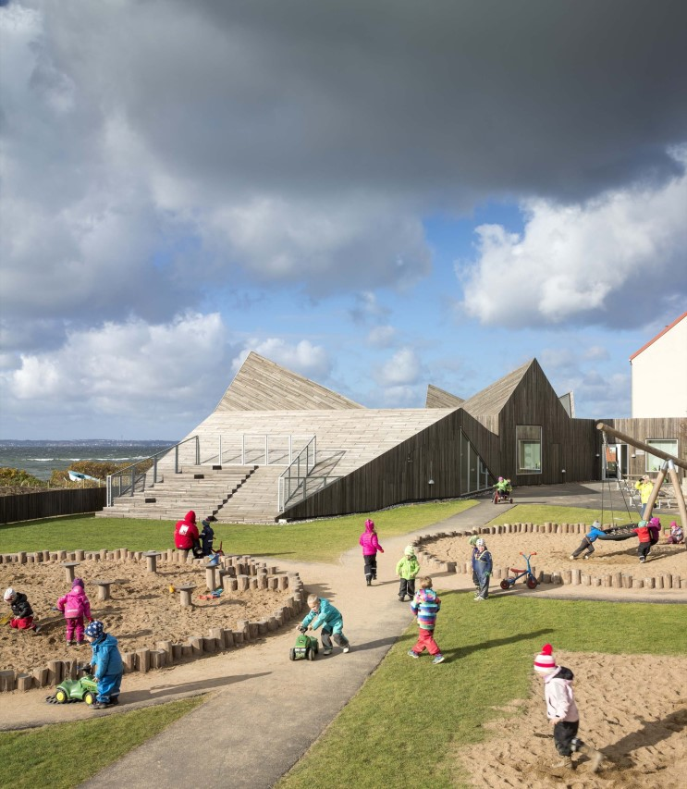
Sand Play

Slide 20
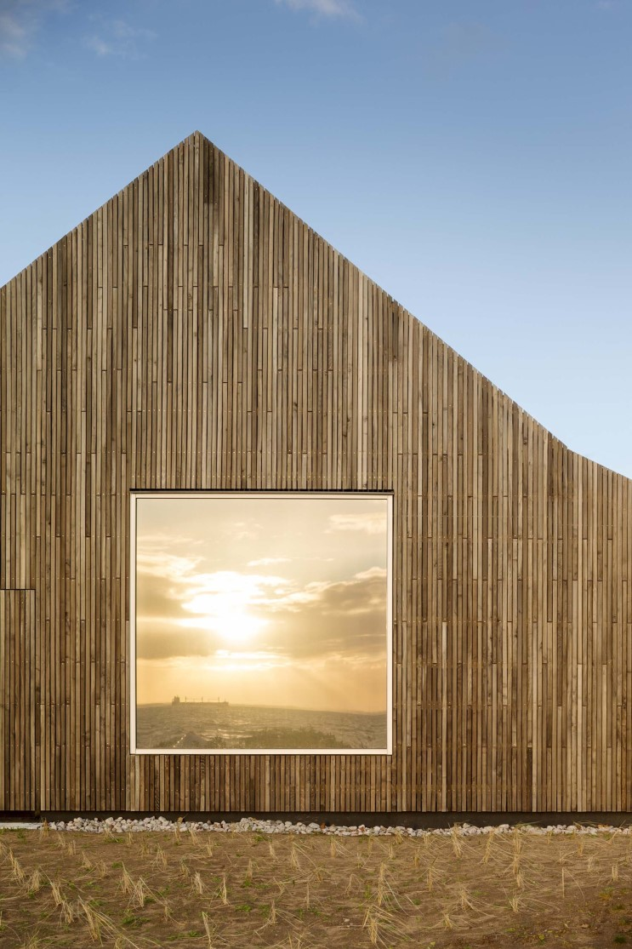
Window Design

Slide 21
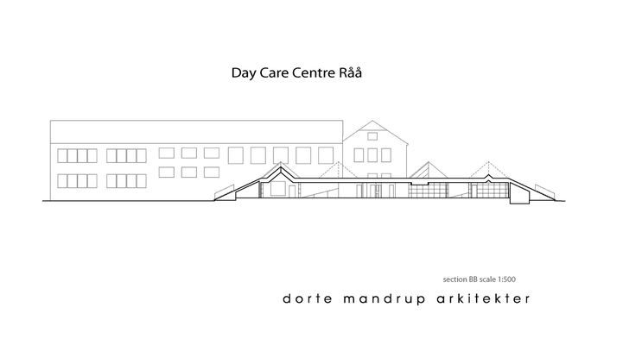
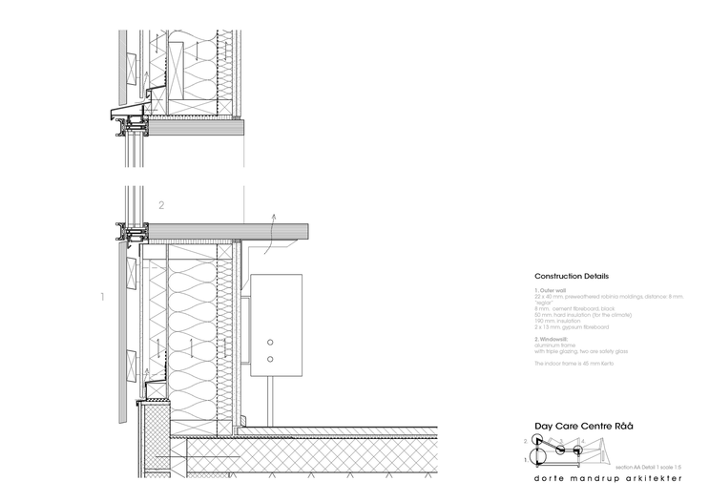
Architecture Planning

Slide 22
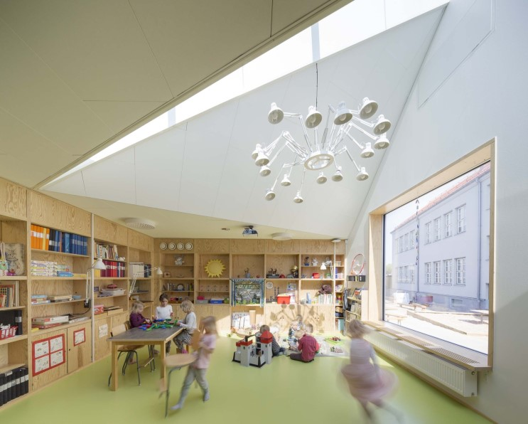
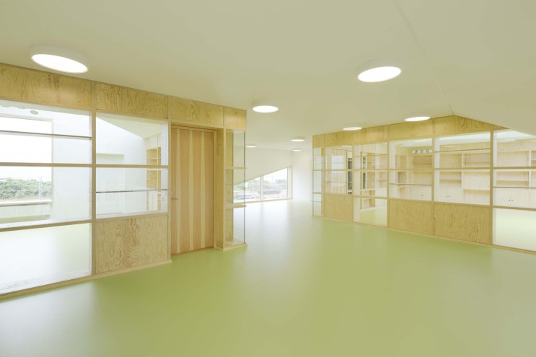
Inside Part

Slide 23
